Slide 1

Noida Institute of Engineering and Technology, Greater Noida
Aptitude-III
Unit: Ⅴ
Subject Name
Statistics & Probability
Dr. Anil Agarwal
Mathematics Department
Course Details B Tech- 3rd Sem.

Slide 2
Noida Institute of Engineering and Technology, Greater Noida
Brief Introduction
Name: Dr. Anil Agarwal
Qualification: M.Sc. , (Agra University), Ph.D. (Dr. B. R. A. University)
Total Exp: 21+ Yrs
Course Taught: Maths-I, Maths-II, Maths-III, S & P

Slide 3
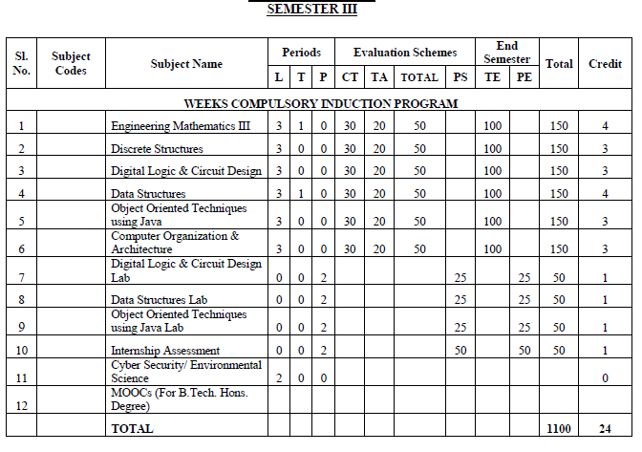
Evaluation Scheme

Slide 4
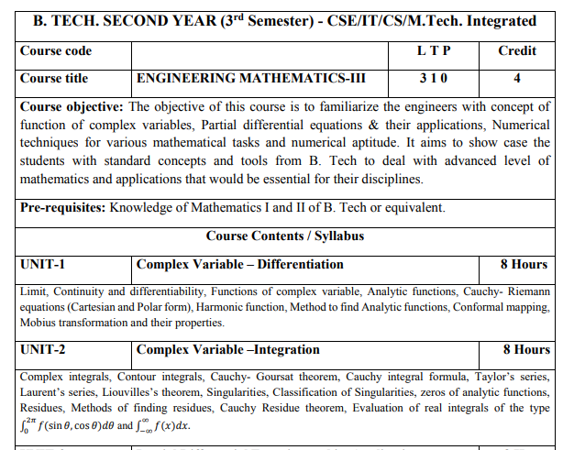
Syllabus

Slide 5
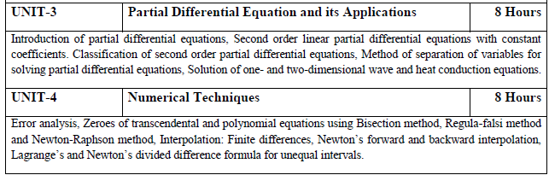
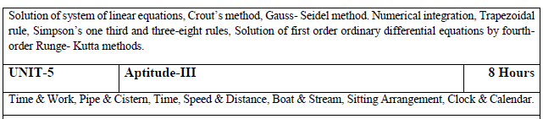
Syllabus

Slide 6
Noida Institute of Engineering and Technology, Greater Noida
Text Book
B. V. Ramana, Higher Engineering Mathematics, Tata McGraw-Hill Publishing Company Ltd., 2008.
B. S. Grewal, Higher Engineering Mathematics, Khanna Publisher, 2005.
R K. Jain & S R K. Iyenger , Advance Engineering Mathematics, Narosa Publishing House 2002.
E. Kreyszig, Advance Engineering Mathematics, John Wiley & Sons, 2005.

Slide 7
Noida Institute of Engineering and Technology, Greater Noida
Reference Books
Peter V. O’Neil, Advance Engineering Mathematics, Thomson (Cengage) Learning, 2007.
Ray Wylie C and Louis C Barret, Advanced Engineering Mathematics, Tata Mc-Graw-Hill; Sixth Edition.

Slide 8
Course Objective
The objective of this course is to familiarize the engineers with concept of function of complex variables, complex variables& their applications, Integral Transforms for various mathematical tasks and numerical aptitude. It aims to show case the students with standard concepts and tools from B. Tech to deal with advanced level of mathematics and applications that would be essential for their disciplines. The students will learn:
The idea of function of complex variables and analytic functions.
The idea of concepts of complex functions for evaluation of definite integrals
The concepts of concept of partial differential equation to solve partial differential and its applications.
The concept of Fourier transform and Z-transform to solve difference equations.
The concept of problems based on Time & Work, Pipe & Cistern, Time, Speed & Distance, Boat & Stream, Sitting Arrangement, Clock & Calendar.

Slide 9
Course Outcome
CO1: Apply the working methods of complex functions for finding analytic functions.
CO2: Apply the concepts of complex functions for finding Taylor’s series, Laurent’s series and evaluation of definite integrals.
CO3: Apply the concept of partial differential equation to solve complex variablesand problems concerned with partial differential equations
CO4: Apply the concept of Fourier transform and Z-transform to solve difference equations.
CO5: Solve the problems of Time & Work, Pipe & Cistern, Time, Speed & Distance, Boat & Stream, Sitting Arrangement , Clock & Calendar.

Slide 10
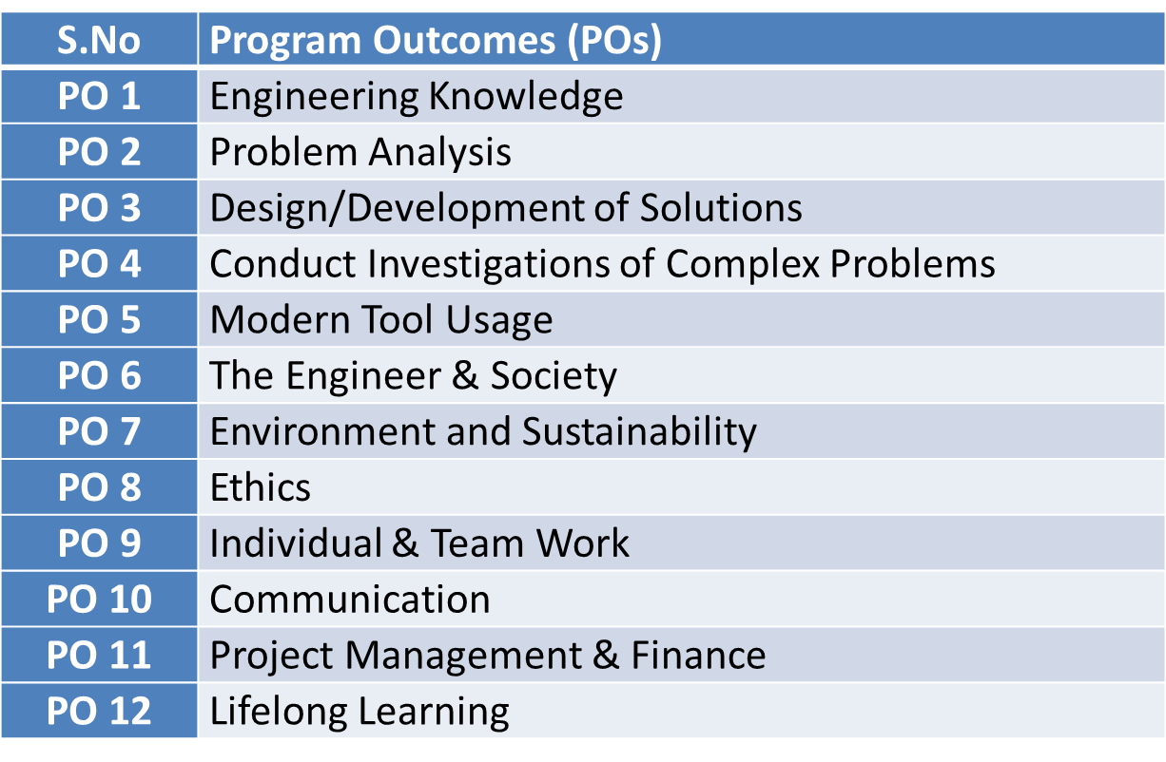
Program Outcomes

Slide 11
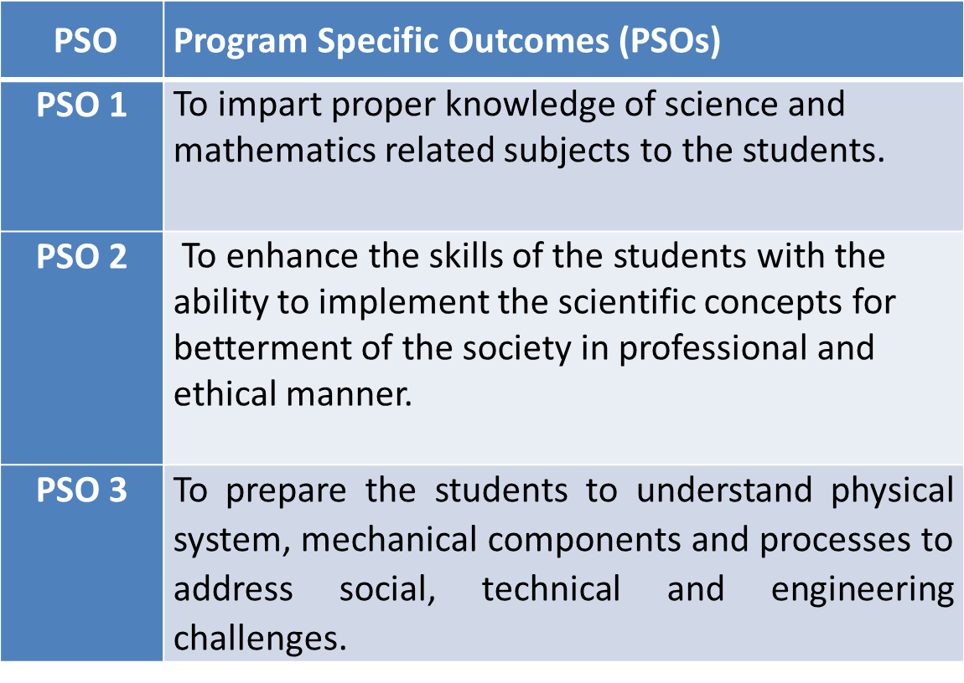
PSO

Slide 12
CO-PO Mapping(CO5)
Sr. No | Course Outcome | PO1 | PO2 | PO3 | PO4 | PO5 | PO6 | PO7 | PO8 | PO9 | PO10 | PO11 | PO12
1 | CO 1 | H | H | H | H | L | L | L | L | L | L | L | M
2 | CO 2 | H | H | H | H | L | L | L | L | L | L | M | M
3 | CO 3 | H | H | H | H | L | L | L | L | L | L | M | M
4 | CO 4 | H | H | H | H | L | L | L | L | L | L | L | M
5 | CO 5 | H | H | H | H | L | L | L | L | L | L | M | M
*L= Low *M= Medium *H= High

Slide 13
CO-PSO Mapping(CO5)
*L= Low *M= Medium *H= High
CO | PSO 1 | PSO 2 | PSO 3
CO.1 | H | L | M
CO.2 | L | M | L
CO.3 | M | M | M
CO.4 | H | M | M
CO.5 | H | M | M

Slide 14
Contents(CO5)
Time & Work
Pipe & Cistern
Time, Speed & Distance
Boat & Stream
Sitting Arrangement
Clocks & Calendar

Slide 15
Module Objective(CO5)
The objective of this course is to familiarize the engineers with concept of function of complex variables. It aims to show case the students with standard concepts and tools from B. Tech to deal with advanced level of mathematics and applications that would be essential for their disciplines

Slide 16
Prerequisite and Recap(CO5)
Knowledge of Maths I B.Tech.
Knowledge of Maths II B.Tech

Slide 17
Topic Objective (CO5)
complex variables:
Complex problems by applying the knowledge acquired to areas that are different to the original ones.
Solving real problems by identifying them appropriately from the perspective of complex variables.
Use appropriate numerical methods to study phenomena modeled with complex variables.

Slide 18
Time & Work
Basic Concepts:
In solving the problems based on time and work, we need to calculate the following parameters.
Time: Time taken to complete an assigned job.
Individual time: Time needed by single person to complete a job.
Work: It is the amount of work done actually.
Important Time and Work Formula:
Knowing the formulas can completely link you to a solution as soon as you read the question. Thus, knowing the formula for any numerical ability topic make the solution and the related calculations simpler.

Slide 19
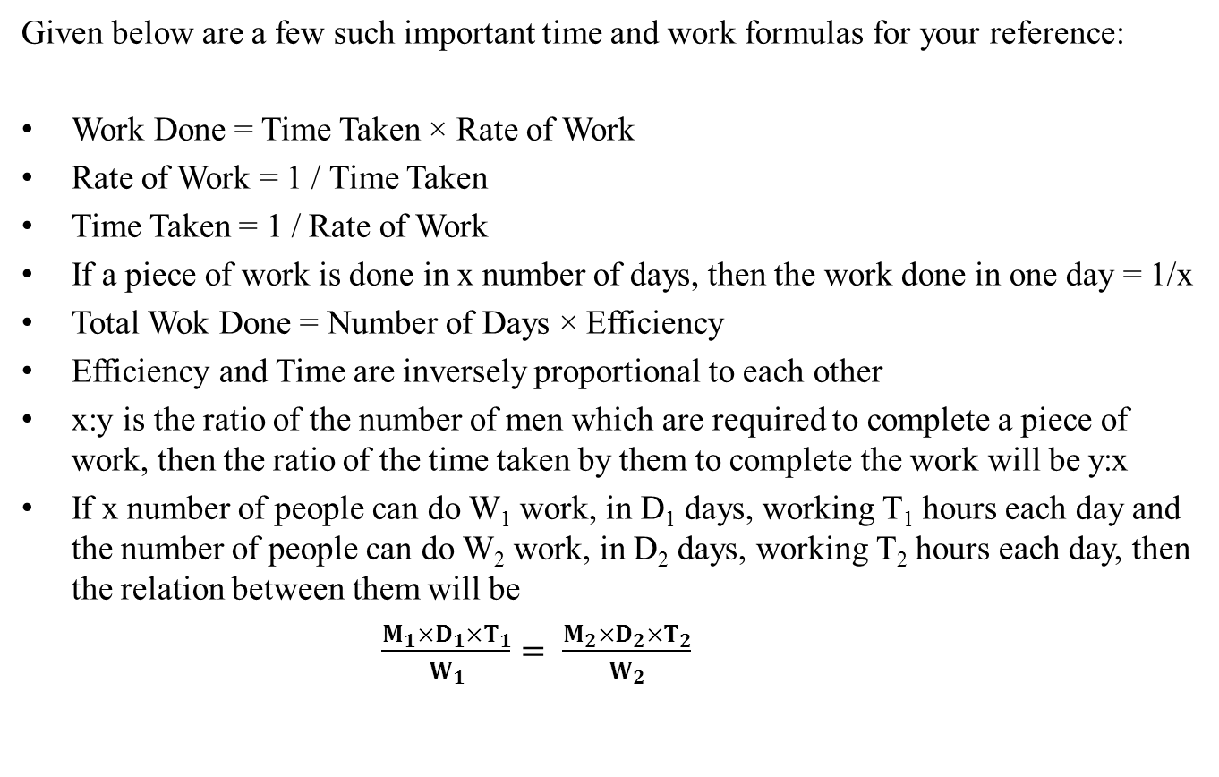
Time & Work (Contd.)
Given below are a few such important time and work formulas for your reference:
Work Done = Time Taken × Rate of Work
Rate of Work = 1 / Time Taken
Time Taken = 1 / Rate of Work
If a piece of work is done in x number of days, then the work done in one day = 1/x
Total Wok Done = Number of Days × Efficiency
Efficiency and Time are inversely proportional to each other
x:y is the ratio of the number of men which are required to complete a piece of work, then the ratio of the time taken by them to complete the work will be y:x
If x number of people can do W₁ work, in D₁ days, working T₁ hours each day and the number of people can do W₂ work, in D₂ days, working T₂ hours each day, then the relation between them will be
$\frac{M_{1}×D_{1}×T_{1}}{W_{1}}= \frac{M_{2}×D_{2}×T_{2}}{W_{2}}$

Slide 20
Time & Work (Contd.)
Example 1: A builder appoints three construction workers Akash, Sunil and Rakesh on one of his sites. They take 20, 30 and 60 days respectively to do a piece of work. How many days will it take Akash to complete the entire work if he is assisted by Sunil and Rakesh every third day?
Solution : Total work done by Akash,Sunil and Rakesh in1day = {(1/20) + (1/30) + (1/60)}
=1/10
Work done along by Akash in 2 days = (1/20) × 2 = 1/10
Work Done in 3 days (1 day of all three together + 2 days of Akash’s work) = (1/10) + (1/10)
= 1/5
So, work done in 3 days = 1/5
Time taken to complete the work = 5×3 = 15 days .

Slide 21
Time & Work (Contd.)
Example 2: To complete a piece of work, Samir takes 6 days and Tanvir takes 8 days alone respectively. Samir and Tanvir took Rs.2400 to do this work. When Amir joined them, the work was done in 3 days. What amount was paid to Amir?
Solution : Total work done by Samir and Tanvir = {(1/6) + (1/8)}
= 7/24
Work done by Amir in 1 day = (1/3) – (7/24)
= 1/24
Amount distributed between each of them = (1/6) : (1/8) : (1/24)
= 4:3:1
Amount paid to Amir = (1/24) × 3 × 2400
= Rs.300

Slide 22
Time & Work (Contd.)
Example3: Dev completed the school project in 20 days. How many days will Arun take to complete the same work if he is 25% more efficient than Dev?
Solution:
Let the days taken by Arun to complete the work be x
The ratio of time taken by Arun and Dev = 125:100
= 5:4
5:4 :: 20:x
⇒ x = {(4×20) / 5}
⇒ x = 16

Slide 23
Time & Work (Contd.)
Example4: Time taken by A to finish a piece of work is twice the time taken B and thrice the time taken by C. If all three of them work together, it takes them 2 days to complete the entire work. How much work was done by B alone?
Solution:
Time taken by A = x days
Time taken by B = x/2 days
Time Taken by C = x/3 days
⇒ {(1/x) + (2/x) + (3/x) = 1/2
⇒ 6/x = 1/2
⇒ x = 12
Time taken by B = x/2 = 12/2 = 6 days

Slide 24
Time & Work (Contd.)
Example5 : Sonal and Preeti started working on a project and they can complete the project in 30 days. Sonal worked for 16 days and Preeti completed the remaining work in 44 days. How many days would Preeti have taken to complete the entire project all by herself?
Solution:
Let the work done by Sonal in 1 day be x
Let the work done by Preeti in 1 day be y
Then, x+y = 1/30 ——— (1)
⇒ 16x + 44y = 1 ——— (2)
Solving equation (1) and (2),
x = 1/60
y = 1/60
Thus, Preeti can complete the entire work in 60 days

Slide 25
Multiple Choice Questions
Q.1 : A can complete a certain work in 4 minutes, B in5 minutes, C in 6 minutes, D in 10 minutes and E in 12 minutes. The average number of units of work completed by them per minute will be
(a) 0.16 (b) 0.40 (c) 0.80 (d) None of these
Q.2: A can finish a work in 18 days and B can do the same work in half the time taken by A. Then, working together, what part of the same work they can finish in a day ?
(a)1/6 (b)1/9 (c) 2/5 (d) 2/7
Q.3: A can complete a work in 6 days while B can complete the same work in 12 days. If they work together and complete it, the portion of the work done by A is
(a)1/3 (b) 1/4 (c) 1/2 (d) 2/3
Q.4: A man can do a job in 15 days. His father takes 20 days and his son finishes it in 25 days. How long will they take to complete the job if they all work together?
(a) Less than 6 days (b) Exactly 6 days (c) Approximately 6.4 days (d) More than 10 days

Slide 26

Multiple Choice Questions
Q.5: Amit and Sumit can plough a field in 4 days. Sumit alone can plough the field in 6 days. In how many days will Amit alone plough the field?
(a) 10 days (b) 12 days (c) 14 days (d) 15 days
Q.6: X, Y and Z complete a work in 6 days. X or Y alone can do the same work in 16 days. In how many days Z alone can finish the same work?
(a) 12 (b) 16 (c) 24 (d) 36
Q.7: A man and a boy together can do a certain amount of digging in 40 days. Their speeds in digging are in the ratio of 8 : 5. How many days will the boy take to complete the work if engaged alone?
(a) 52 days (b) 68 days (c) 80 days (d) 104 days
Q.8: A takes twice as much time as B or thrice as much time as C to finish a piece of work. Working together, they can finish the work in 2 days. B can do the work alone in :
(a) 4 days (b) 6 days (c) 8 days (d) 12 days

Slide 27
Daily Quiz
A and B together can complete a piece of work in 15 days and B alone in 20 days. In how many days can A alone complete the work?
A can do a work in 4 days, B in 5 days and C in 10 days. Find the time taken by A, B and C to do the work together?
If Roger can do a piece of work in 8 days and Antony can complete the same work in 5 days, in how many days will both of them together complete it?

Slide 28
Assignment - 1
Q. 1 : X and Y can do a piece of work in 20 days and 12 days respectively. X started the work alone and then after 4 days Y joined him till the completion of the work. How long did the work last ?
6 days (b) 10 days (c) 15 days (d) 20 days
Q.2: A man and a boy can do a piece of work in 24 days. If the man works alone for the last 6 days, it is completed in 26 days. How long would the boy take to do it alone?
20 days (b) 24 days (c) 36 days (d) 72 days
Q.3: A and B can together finish a work in 30 days. They worked together for 20 days and then B left. After another 20 days, A finished the remaining work. In how many days A alone can finish the job ?
(a) 40 (b) 50 (c) 54 (d) 60
Q.4: A, B and C together can complete a piece of work in 10 days. All the three started working at it together and after 4 days A left. Then B and C together completed the work in 10 more days. A alone could complete the work in :
(a) 15 days (b) 16 days (c) 25 days (d) 50 days

Slide 29
Assignment – 1(Contd.)
Q.5: A and B together can do a piece of work in 30 days. A having worked for 16 days, B finishes the remaining work alone in 44 days. In how many days shall B finish the whole work alone ?
(a) 30 days (b) 40 days (c) 60 days (d) 70 days
Q.6: A man and a boy received Rs 800 as wages for 5 days for the work they did together. The man’s efficiency in the work was three times that of the boy. What are the daily wages of the boy?
(a) Rs 40 (b) Rs 44 (c) Rs 56 (d) Rs 76
Q.7: A, B and C together earn Rs 300 per day, while A and C together earn Rs 188 and B and C together earn Rs 152. The daily earning of C is :
(a) Rs 40 (b) Rs 68 (c) Rs 112 (d) Rs 150

Slide 30
Assignment – 1(Contd.)
Q.8: A and B together can complete a work in 12 days. A alone can complete it in 20 days. If B does the work only for half a day daily, then in how many days A and B together will complete the work ?
110 days (b) 11 days(c) 15 days (d) 20 days
Q.9: A man, a woman and a boy can do a piece of work in 6, 9 and 18 days respectively. How many boys must assist one man and one woman to do the work in 1 day?
(a) 5 (b) 6 (c) 9 (d) 13
Q.10: 16 men can finish a work in 24 days and 48 boys can finish the same work in 16 days. 12 men started the work and after 4 days 12 boys joined them. In how many days can they finish the remaining work?
(a) 6 (b) 12 (c) 16 (d) None of these

Slide 31
Pipe &Cistern
IMPORTANT FACTS AND FORMULAE
Inlet: A pipe connected with a tank or a cistern or a reservoir, that fills it, is known as an inlet.
Outlet: A pipe connected with a tank or a cistern or a reservoir, emptying it, is known as an outlet.
(i) If a pipe can fill a tank in x hours, then part filled in 1 hour =1/x
(ii) If a pipe can empty a full tank in y hours, then part emptied in 1 hour =1/y
(iii) If a pipe can fill a tank in x hours and another pipe can empty the full tank in y hours (where y > x), then on opening both the pipes, the net part filled in 1 hour =(1/x-1/y)
If a pipe can fill a tank in x hours and another pipe can empty the full tank in y hours (where x > y), then on opening both the pipes, the net part emptied in 1 hour =(1/y-1/x)

Slide 32
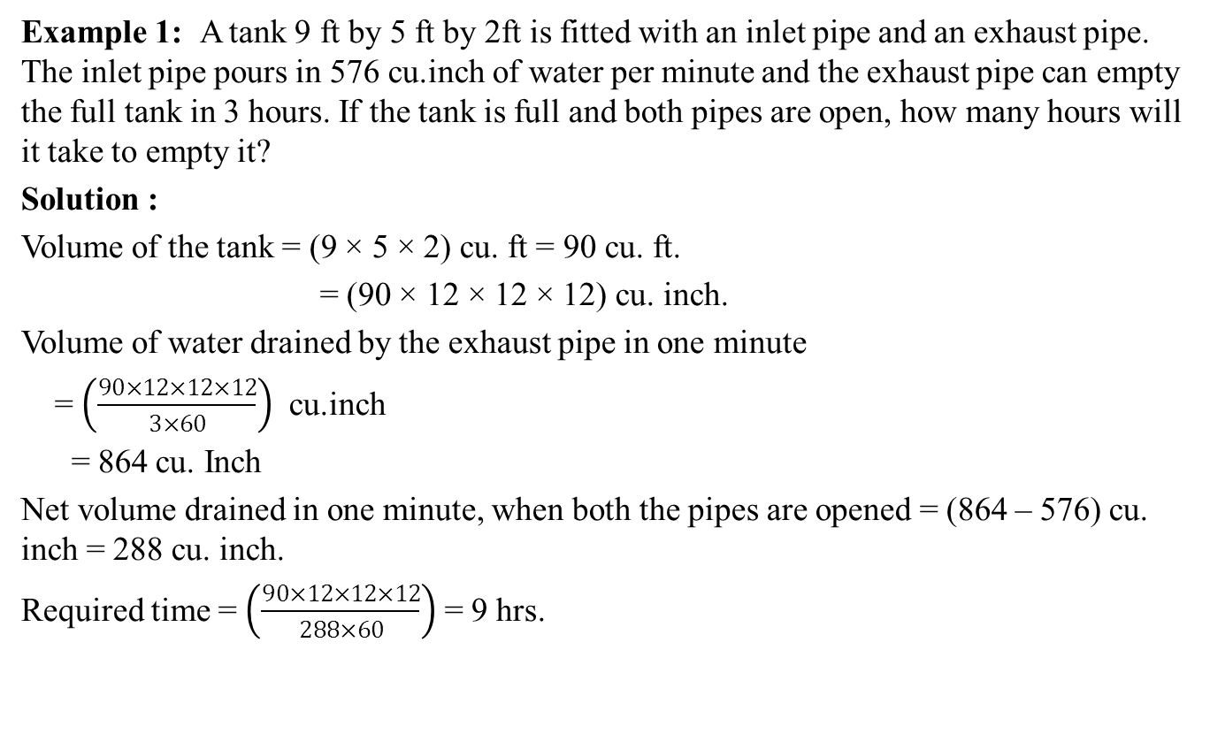
Pipe &Cistern ( Contd. )
Example 1: A tank 9 ft by 5 ft by 2ft is fitted with an inlet pipe and an exhaust pipe. The inlet pipe pours in 576 cu.inch of water per minute and the exhaust pipe can empty the full tank in 3 hours. If the tank is full and both pipes are open, how many hours will it take to empty it?
Solution :
Volume of the tank = (9 × 5 × 2) cu. ft = 90 cu. ft.
= (90 × 12 × 12 × 12) cu. inch.
Volume of water drained by the exhaust pipe in one minute
= $\left(\frac{90×12×12×12}{3×60}\right)$ cu.inch
= 864 cu. Inch
Net volume drained in one minute, when both the pipes are opened = (864 – 576) cu. inch = 288 cu. inch.
Required time = $\left(\frac{90×12×12×12}{288×60}\right)$ = 9 hrs.

Slide 33
Pipe &Cistern ( Contd. )
Example 2 : Pipe A can fill a tank in 30 hours and pipe B in 45 hours. If both the pipes are opened in an empty tank, how much time will they take to fill it?
Solution : Part filled by A in 1 hour =1/30
Part filled by B in 1 hour =1/45
Part filled by (A + B) in 1 hour =(1/30 +1/45) = 1/18
Hence, pipes A and B together will fill the tank in 18 hours.
Example 3 : A tap can fill a tank in 10 minutes and another can empty it in 6 minutes. If the tank is already two-fifths full and both the taps are opened together, will the tank be filled or emptied? How long will it take before the tank is either filled completely or emptied completely, as the case may be?
Solution : Clearly, the outlet pipe is faster than the inlet pipe and so, the tank will be emptied.
Part to be emptied =2/5
Net part emptied in 1 minute = (1/6 -1/10) = 1/15
∴ 1/15 : 2/5 :: 1:x or x= 2/5 ×1 ×15 = 6 min.
So, the tank will be emptied in 6 minutes.

Slide 34
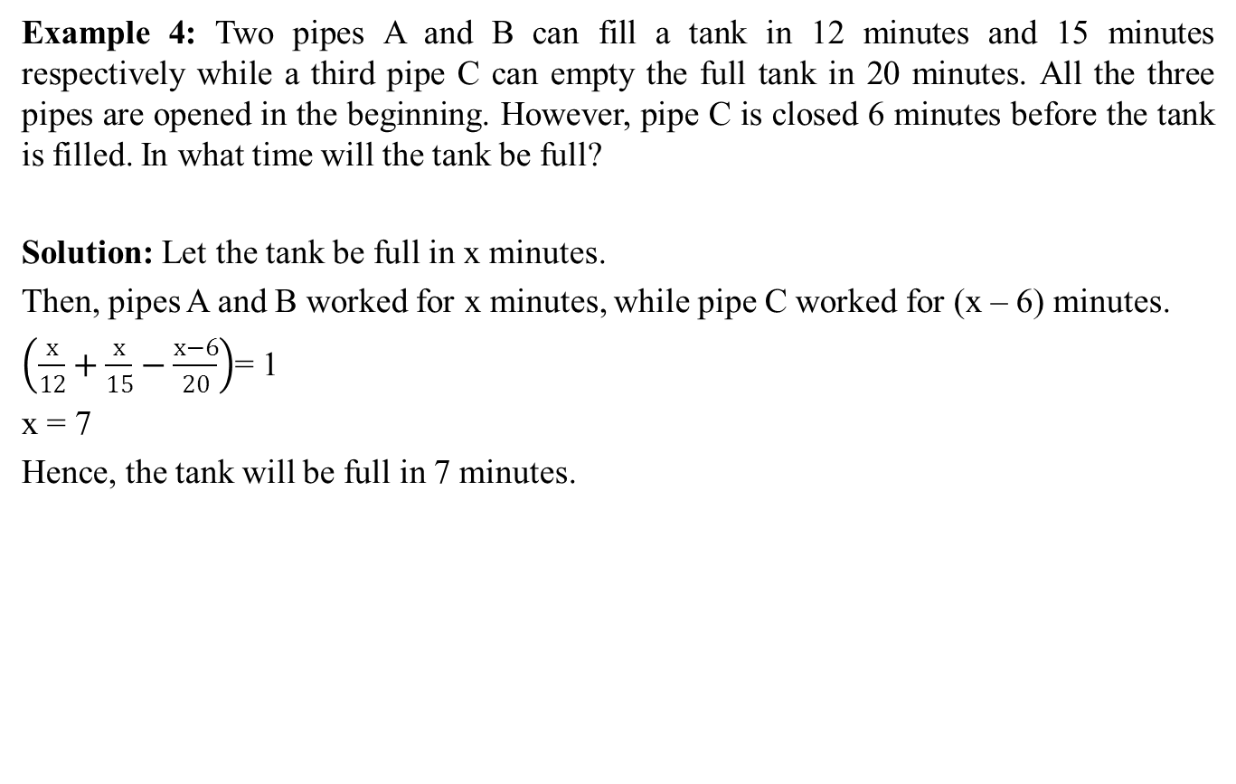
Pipe &Cistern ( Contd. )
Example 4: Two pipes A and B can fill a tank in 12 minutes and 15 minutes respectively while a third pipe C can empty the full tank in 20 minutes. All the three pipes are opened in the beginning. However, pipe C is closed 6 minutes before the tank is filled. In what time will the tank be full?
Solution: Let the tank be full in x minutes.
Then, pipes A and B worked for x minutes, while pipe C worked for (x – 6) minutes.
$\left(\frac{x}{12}+\frac{x}{15}−\frac{x−6}{20}\right)$= 1
x = 7
Hence, the tank will be full in 7 minutes.

Slide 35
Multiple Choice Questions
Q.1 : Two pipes A and B can fill a tank in 20 and 30 minutes respectively. If both the pipes are used together, how long will it take to fill the tank?
(a) 12 minutes (b) 15 minutes (c) 25 minutes (d) 50 minutes
Q.2: A tap can completely fill a water tank in 8 hours. The water tank has a hole in it through which the water leaks out. The leakage will cause the full water tank to get empty in 12 hours. How much time will it take for the tap to fill the tank completely with the hole?
(a) 16 hours (b) 18 hours (c) 24 hours (d) None of these
Q.3: A tap can fill a tank in 6 hours. After half the tank is filled, three more similar taps are opened. What is the total time taken to fill the tank completely?
3 hrs 15 min (b) 3 hrs 45 min (c) 4 hrs (d) 4 hrs 15 min
Q.4: One pipe can fill a tank three times as fast as another pipe. If together the two pipes can fill the tank in 36 minutes, then the slower pipe alone will be able to fill the tank in
(a) 81 min (b) 108 min (c) 144 min (d) 192 min

Slide 36
Multiple Choice Questions
Q.5: 12 buckets of water fill a tank when the capacity of each bucket is 13.5 litres. How many buckets will be needed to fill the same tank, if the capacity of each bucket is 9 litres?
(a) 8 (b) 15 (c) 16 (d) 18
Q.6: Bucket P has thrice the capacity as bucket Q. It takes 60 turns for bucket P to fill the empty drum. How many turns will it take for both the buckets P and Q, having each turn together to fill the empty drum?
(a) 30 (b) 40 (c) 45 (d) 90
Q.7: Two pipes A and B can fill a tank in 15 hours and 20 hours respectively while a third pipe C can empty the full tank in 25 hours. All the three pipes are opened in the beginning. After 10 hours, C is closed. In how much time will the tank be full?
12 hrs (b) 13 hrs (c) 16 hrs (d) 18 hrs
Q.8: Two pipes A and B can fill a tank in 24h and 30 h respectively. If both the pipes are opened simultaneously in the empty tank, how much time will be taken by them to fill it?
(a) 13h 20 min (b) 12h 10min (c) 14h (d) 10h 5min

Slide 37
Daily Quiz
Two pipes A and B can fill a tank in 24 minutes and 32 minutes respectively. If both the pipes are opened simultaneously, after how much time B should be closed so that the tank is full in 18 minutes?
Three pipes A, B and C are attached to a tank. A and B can fill it in 20 and 30 minutes respectively whilen C can empty it in 15 minutes. If A, B and C are kept open successively for 1 minute each, how soon will the tank be filled?
A cistern has three pipes A, B and C. A and B can fill it in 3 hours and 4 hours respectively while C can empty the completely filled cistern in 1 hour. If the pipes are opened in order at 3, 4 and 5 p.m. respectively, at what time will the cistern be empty?

Slide 38
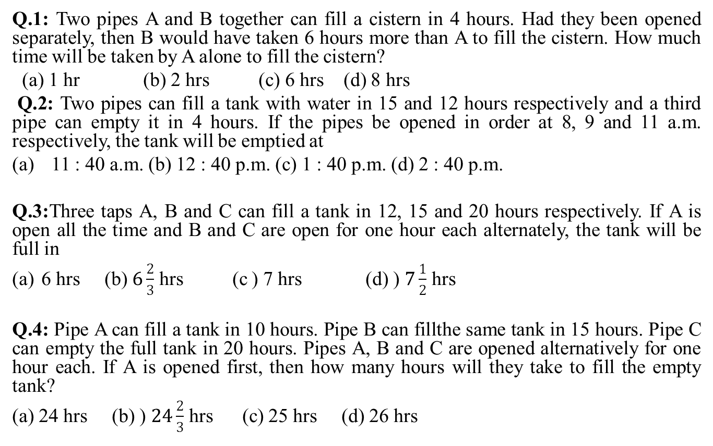
Assignment-2
Q.1: Two pipes A and B together can fill a cistern in 4 hours. Had they been opened separately, then B would have taken 6 hours more than A to fill the cistern. How much time will be taken by A alone to fill the cistern?
(a) 1 hr (b) 2 hrs (c) 6 hrs (d) 8 hrs
Q.2: Two pipes can fill a tank with water in 15 and 12 hours respectively and a third pipe can empty it in 4 hours. If the pipes be opened in order at 8, 9 and 11 a.m. respectively, the tank will be emptied at
11 : 40 a.m. (b) 12 : 40 p.m. (c) 1 : 40 p.m. (d) 2 : 40 p.m.
Q.3:Three taps A, B and C can fill a tank in 12, 15 and 20 hours respectively. If A is open all the time and B and C are open for one hour each alternately, the tank will be full in
6 hrs (b) $6\frac{2}{3}$ hrs (c ) 7 hrs (d) ) $7\frac{1}{2}$ hrs
Q.4: Pipe A can fill a tank in 10 hours. Pipe B can fillthe same tank in 15 hours. Pipe C can empty the full tank in 20 hours. Pipes A, B and C are opened alternatively for one hour each. If A is opened first, then how many hours will they take to fill the empty tank?
(a) 24 hrs (b) ) $24\frac{2}{3}$ hrs (c) 25 hrs (d) 26 hrs

Slide 39
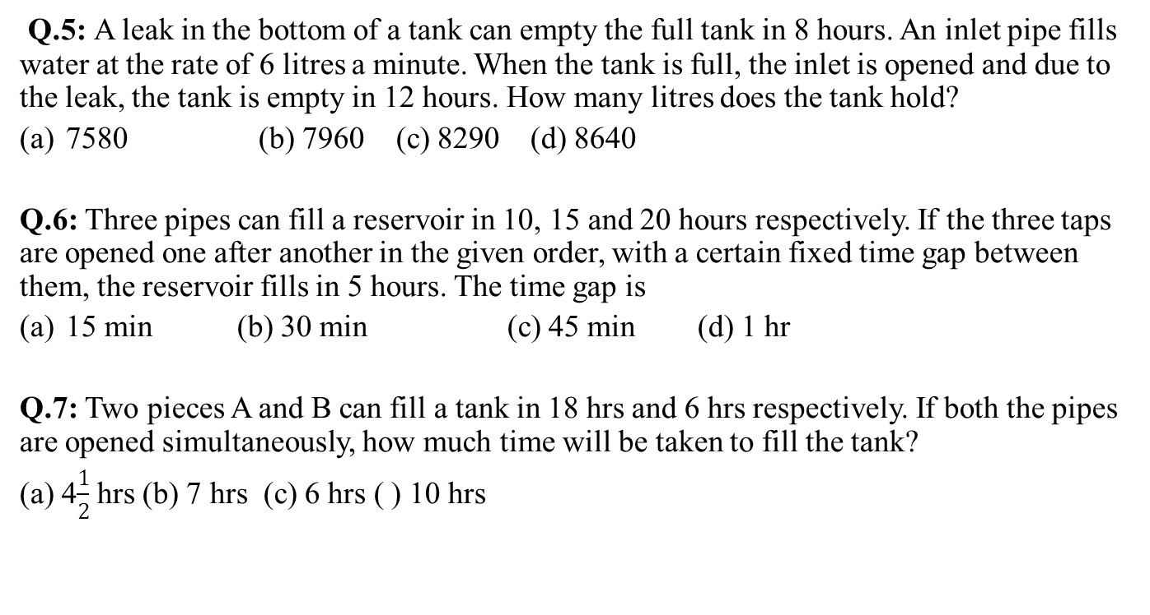
Assignment-2 (Contd.)
Q.5: A leak in the bottom of a tank can empty the full tank in 8 hours. An inlet pipe fills water at the rate of 6 litres a minute. When the tank is full, the inlet is opened and due to the leak, the tank is empty in 12 hours. How many litres does the tank hold?
7580 (b) 7960 (c) 8290 (d) 8640
Q.6: Three pipes can fill a reservoir in 10, 15 and 20 hours respectively. If the three taps are opened one after another in the given order, with a certain fixed time gap between them, the reservoir fills in 5 hours. The time gap is
15 min (b) 30 min (c) 45 min (d) 1 hr
Q.7: Two pieces A and B can fill a tank in 18 hrs and 6 hrs respectively. If both the pipes are opened simultaneously, how much time will be taken to fill the tank?
(a) 4$\frac{1}{2}$ hrs (b) 7 hrs (c) 6 hrs ( ) 10 hrs

Slide 40
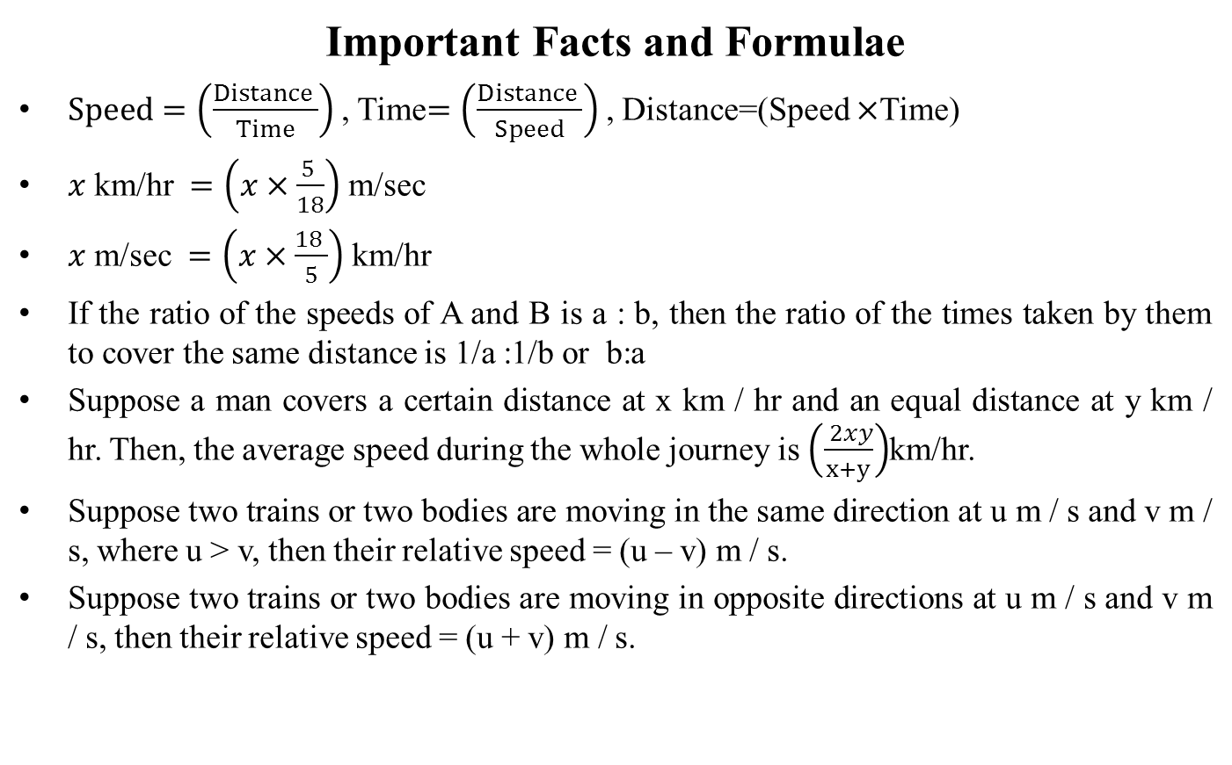
Time Speed and Distance
Important Facts and Formulae
$Speed=\left(\frac{Distance }{Time}\right)$ , Time$=\left(\frac{Distance }{Speed}\right)$ , Distance=(Speed $×$Time)
$x$ km/hr $=\left(x×\frac{5 }{18}\right)$ m/sec
$x$ m/sec $=\left(x×\frac{18 }{5}\right)$ km/hr
If the ratio of the speeds of A and B is a : b, then the ratio of the times taken by them to cover the same distance is 1/a :1/b or b:a
Suppose a man covers a certain distance at x km / hr and an equal distance at y km / hr. Then, the average speed during the whole journey is $\left(\frac{ 2xy}{x+y}\right)$km/hr.
Suppose two trains or two bodies are moving in the same direction at u m / s and v m / s, where u > v, then their relative speed = (u – v) m / s.
Suppose two trains or two bodies are moving in opposite directions at u m / s and v m / s, then their relative speed = (u + v) m / s.

Slide 41
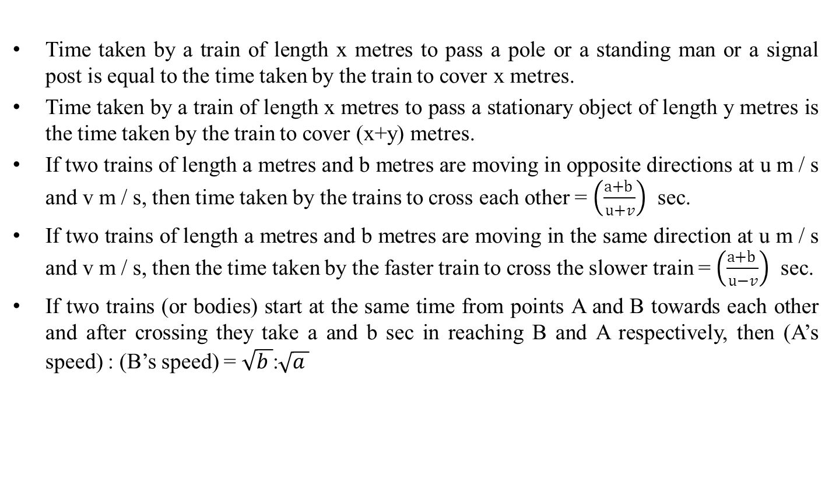
ALIIGATION & MIXTURE
Time Speed and Distance(Contd.)
Time taken by a train of length x metres to pass a pole or a standing man or a signal post is equal to the time taken by the train to cover x metres.
Time taken by a train of length x metres to pass a stationary object of length y metres is the time taken by the train to cover (x+y) metres.
If two trains of length a metres and b metres are moving in opposite directions at u m / s and v m / s, then time taken by the trains to cross each other = $\left(\frac{a+b }{u+v}\right)$ sec.
If two trains of length a metres and b metres are moving in the same direction at u m / s and v m / s, then the time taken by the faster train to cross the slower train = $\left(\frac{a+b }{u−v}\right)$ sec.
If two trains (or bodies) start at the same time from points A and B towards each other and after crossing they take a and b sec in reaching B and A respectively, then (A’s speed) : (B’s speed) = $\sqrt{b }$:$\sqrt{a }$

Slide 42
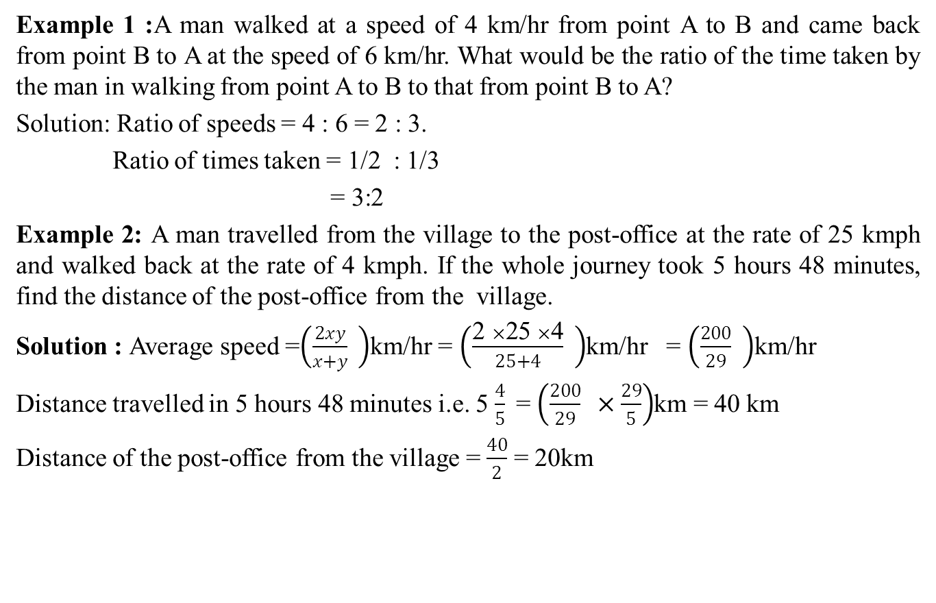
Time Speed and Distance(Contd.)
Example 1 :A man walked at a speed of 4 km/hr from point A to B and came back from point B to A at the speed of 6 km/hr. What would be the ratio of the time taken by the man in walking from point A to B to that from point B to A?
Solution: Ratio of speeds = 4 : 6 = 2 : 3.
Ratio of times taken = 1/2 : 1/3
= 3:2
Example 2: A man travelled from the village to the post-office at the rate of 25 kmph and walked back at the rate of 4 kmph. If the whole journey took 5 hours 48 minutes, find the distance of the post-office from the village.
Solution : Average speed =$\left(\frac{2xy}{x+y} \right)$km/hr = $\left(\frac{\text{2 }×\text{25 }×\text{4}}{25+4} \right)$km/hr = $\left(\frac{200}{29} \right)$km/hr
Distance travelled in 5 hours 48 minutes i.e. 5 $\frac{4}{5}$= $\left(\frac{200}{29} ×\frac{29}{5}\right)$km = 40 km
Distance of the post-office from the village = $\frac{40}{2}$ = 20km

Slide 43
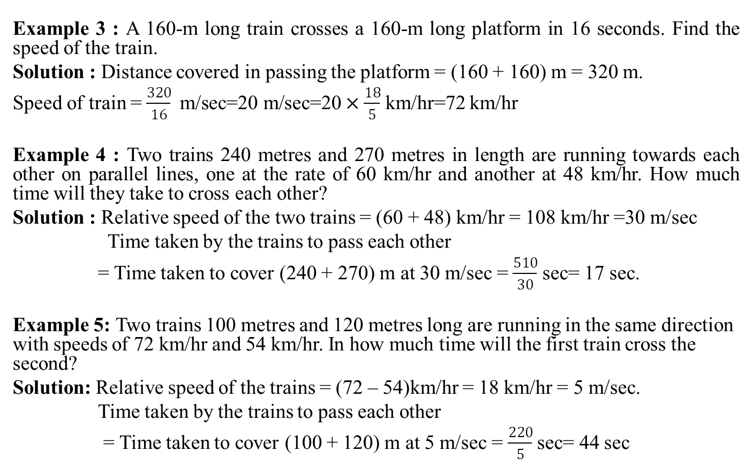
Assignment - 1
Time Speed and Distance(Contd.)
Example 3 : A 160-m long train crosses a 160-m long platform in 16 seconds. Find the speed of the train.
Solution : Distance covered in passing the platform = (160 + 160) m = 320 m.
Speed of train = $\frac{320}{16} \text{m}\text{/}\text{sec}\text{=20 }\text{m}\text{/}\text{sec}\text{=20}×\frac{18}{5}$ km/hr=72 km/hr
Example 4 : Two trains 240 metres and 270 metres in length are running towards each other on parallel lines, one at the rate of 60 km/hr and another at 48 km/hr. How much time will they take to cross each other?
Solution : Relative speed of the two trains = (60 + 48) km/hr = 108 km/hr =30 m/sec
Time taken by the trains to pass each other
= Time taken to cover (240 + 270) m at 30 m/sec = $\frac{510}{30}$ sec= 17 sec.
Example 5: Two trains 100 metres and 120 metres long are running in the same direction with speeds of 72 km/hr and 54 km/hr. In how much time will the first train cross the second?
Solution: Relative speed of the trains = (72 – 54)km/hr = 18 km/hr = 5 m/sec.
Time taken by the trains to pass each other
= Time taken to cover (100 + 120) m at 5 m/sec = $\frac{220}{5}$ sec= 44 sec

Slide 44
Assignment - 1
Multiple Choice Questions
Q. 1: A motorist travelled between two towns, which are 65 km apart, in 2 hours and 10 minutes. Find the speed in metres per minute.
(a) 200 (b) 500 (c) 600 (d) 700
Q.2: A train leaves Delhi at 4.10 P.M. and reaches Aligarh at 7.25 P.M. The average speed of the train is 40 km/hr. What is the distance from Delhi to Aligarh?
(a) 120 km (b) 130 km (c) 135 km (d) 140 km
Q.3: A monkey climbing up a pole ascends 6 metres and slips 3 metres in alternate minutes. If the pole is 60 metres high, how long will it take the monkey to reach the top?
(a) 31 min (b) 33 min (c) 35 min (d) 37 min
Q.4: A car is driven at the speed of 100 km/hr and stops for 10 minutes at the end of every 150 km. To cover a distance of 1000 km, it will take
(a) 9 hours (b) 10 hours (c) 11 hours (d) 12 hours

Slide 45
Multiple Choice Questions
Q 5:A train covers a distance of 12 km in 10 minutes. If it takes 6 seconds to pass a telegraph post, then the length of the train is
(a) 90 m (b) 100 m (c) 120 m (d) 140 m
Q.6: The length of the bridge, which a train 130 metres long and travelling at 45 km / hr can cross in 30 seconds, is
(a) 200 m (b) 225 m (c) 245 m (d) 250 m
Q.7: A train travelling with a constant speed crosses a 96-metre long platform in 12 seconds and another 141-metre long platform in 15 seconds. The length of the train and its speed are
(a) 84 metres and 54 km/hr (b) 64 metres and 44 km/hr
(c) 64 metres and 54 km/hr (d) 84 metres and 60 km/hr

Slide 46
Profit & Loss
Multiple Choice Questions
Q.8:A train with 90 km/hr crosses a bridge in 36 seconds. Another train 100 metres shorter crosses the same bridge at 45 km/hr. What is the time taken by the second train to cross the bridge?
61 seconds (b) 62 seconds (c) 63 seconds (d) 64 seconds
Q.9: Two trains of lengths 120 m and 90 m are running with speeds of 80 km/hr and 55 km/hr respectively towards each other on parallel lines. If they are 90 m apart, after how many seconds they will cross each other?
(a) 5.6 sec. (b) 7.2 sec. (c) 8 sec. (d) 9 sec.
Q.10: A car travels from P to Q at a constant speed. If its speed were increased by 10 km/hr, it would have taken one hour lesser to cover the distance. It would have taken further 45 minutes lesser if the speed was further increased by 10 km/hr. What is the distance between the two cities?
(a) 420 km (b) 540 km (c) 600 km (d) 650 km

Slide 47
Daily Quiz
A bus covered a certain distance from village A to village B at the speed of 60 km/hr. However on its return journey it got stuck in traffic and covered the same distance at the speed of 40 km/hr and took 2 hours more to reach its destination. What is the distance covered between villages A and B?
A car takes 15 minutes less to cover a distance of 75 km, if it increases its speed by 10 km/hr from its usual speed. How much time would it take to cover a distance of 300 km using this speed?
Two men starting from the same place walk at the rate of 5 kmph and 5.5 kmph respectively. What time will they take to be 8.5 km apart, if they walk in the same direction?

Slide 48
Assignment - 3
Q.1 : If Karan travels at a speed of 60 kmph and covers a distance in 9 hrs., then how much time will he take to travel the same distance at a speed of 90 kmph?
8 hrs (b) 6 hrs (c) 12 hrs (d) 9 hrs
Q.2: A car covers 650 km in 12 hours and other 850 kmin 18 hours. Find the average speed of the car ?
47 kmph (b) 50 kmph (c) 48 kmph (d) 52 kmph
Q.3: A car travels the first one third of a certain distance with a speed of 10 km/hr, the next one third distance with a speed of 20 km/hr and the last one third distance with a speed of 60 km/hr. The average speed of the car for the whole journey is
18 km/hr (b) 24 km/hr (c) 30 km/hr (d) 36 km/hr
Q.4: A thief is noticed by a policeman from a distance of 200 m. The thief starts running and the policeman chases him. The thief and the policeman chases him. The thief and the policeman run at the speed of 10km/hr and 11 km/hr respectively. What is the distance between them after 6 minutes?
(a) 100m (b) 120m (c) 150m (d) 160m

Slide 49
Profit & Loss(Contd.)
Assignment – 3 (Contd.)
Q.5: Ramesh is walking at a speed of 10 kilometres per hour. After every kilometer he takes rest for 5 minutes. The time taken to cover a distance of 5 kilometres by Ramesh is
30 minutes (b) 35 minutes (c) 50 minutes (d) 55 minutes
Q.6: Train A passes a lamp post in 9 seconds and 700 meter long platform in 30 seconds. How much time will the same train take to cross a platform which is 800 meters long? (in seconds)
32 (b) 31 (c) 33 (d) 30
Q.7: A train passes two bridges of lengths 500 m and 250 m in 100 seconds and 60 seconds respectively. The length of the train is
152 m (b) 125 m (c) 250 m (d) 120 m

Slide 50
Profit & Loss (Contd.)
Assignment – 3 (Contd.)
Q.8: Two trains start at the same time form A and B and proceed toward each other at the speed of 75 km/hr and 50 km/hr respectively. when both meet at a point in between, one train was found to have travelled 175 km more than the other. Find the distance between A and B.
875 km (b) 785 km (c) 758 km (d) 857 km
Q.9: Two identical trains A and B running in opposite directions at same speed take 2 minutes to cross each other completely. The number of bogies of A are increased from 12 to 16. How much more time would they now require to cross each other?
(a) 20 sec (b) 40 sec (c) 50 sec (d) 60 sec
Q.10: Two trains, one from Howrah to Patna and the other from Patna to Howrah, start simultaneously. After they meet, the trains reach their destinations after 9 hours and 16 hours respectively. The ratio of their speeds is :
(a) 2 : 3 (b) 4 : 3 (c) 6 : 7 (d) 9 : 16

Slide 51
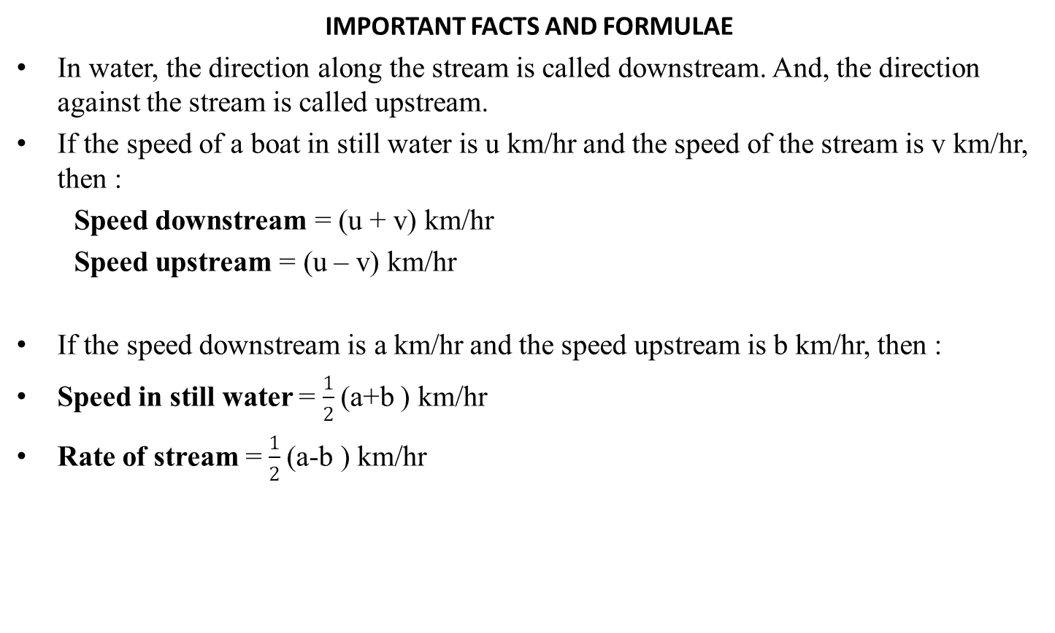
Boat and Stream
IMPORTANT FACTS AND FORMULAE
In water, the direction along the stream is called downstream. And, the direction against the stream is called upstream.
If the speed of a boat in still water is u km/hr and the speed of the stream is v km/hr, then :
Speed downstream = (u + v) km/hr
Speed upstream = (u – v) km/hr
If the speed downstream is a km/hr and the speed upstream is b km/hr, then :
Speed in still water = $\frac{1}{2}$(a+b ) km/hr
Rate of stream = $\frac{1}{2}$(a-b ) km/hr

Slide 52
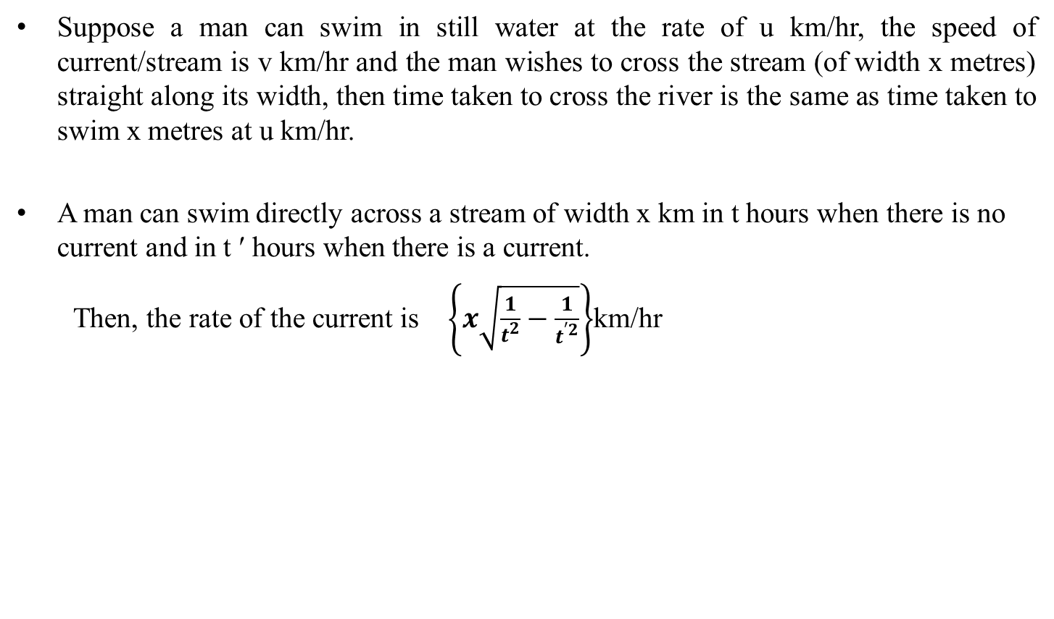
Discount(Contd.)
Boat and Stream (Contd.)
Suppose a man can swim in still water at the rate of u km/hr, the speed of current/stream is v km/hr and the man wishes to cross the stream (of width x metres) straight along its width, then time taken to cross the river is the same as time taken to swim x metres at u km/hr.
A man can swim directly across a stream of width x km in t hours when there is no current and in t ′ hours when there is a current.
Then, the rate of the current is $\left\{x\sqrt{\frac{1}{t^{2}}−\frac{1}{t^{′2}}}\right\}$km/hr

Slide 53
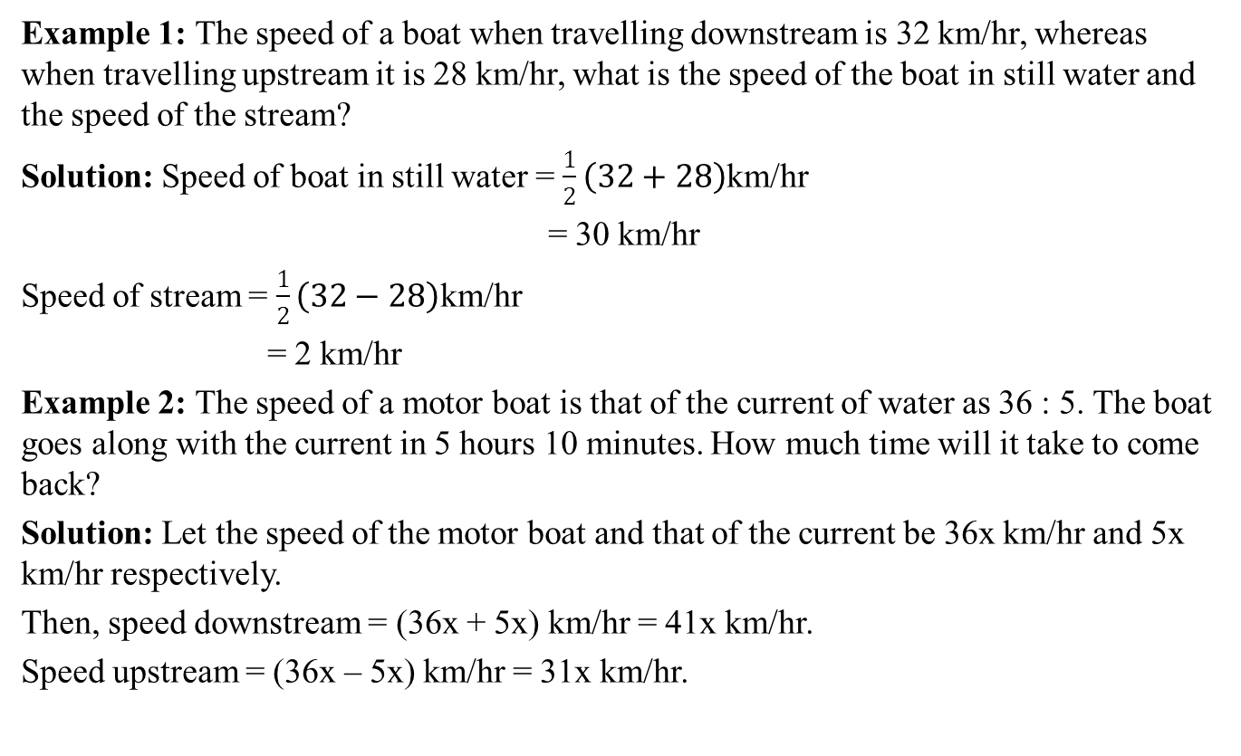
Discount (Contd.)
Boat and Stream
Example 1: The speed of a boat when travelling downstream is 32 km/hr, whereas when travelling upstream it is 28 km/hr, what is the speed of the boat in still water and the speed of the stream?
Solution: Speed of boat in still water = $\frac{1}{2}\left(32+28\right)$km/hr
= 30 km/hr
Speed of stream = $\frac{1}{2}\left(32−28\right)$km/hr
= 2 km/hr
Example 2: The speed of a motor boat is that of the current of water as 36 : 5. The boat goes along with the current in 5 hours 10 minutes. How much time will it take to come back?
Solution: Let the speed of the motor boat and that of the current be 36x km/hr and 5x km/hr respectively.
Then, speed downstream = (36x + 5x) km/hr = 41x km/hr.
Speed upstream = (36x – 5x) km/hr = 31x km/hr.

Slide 54
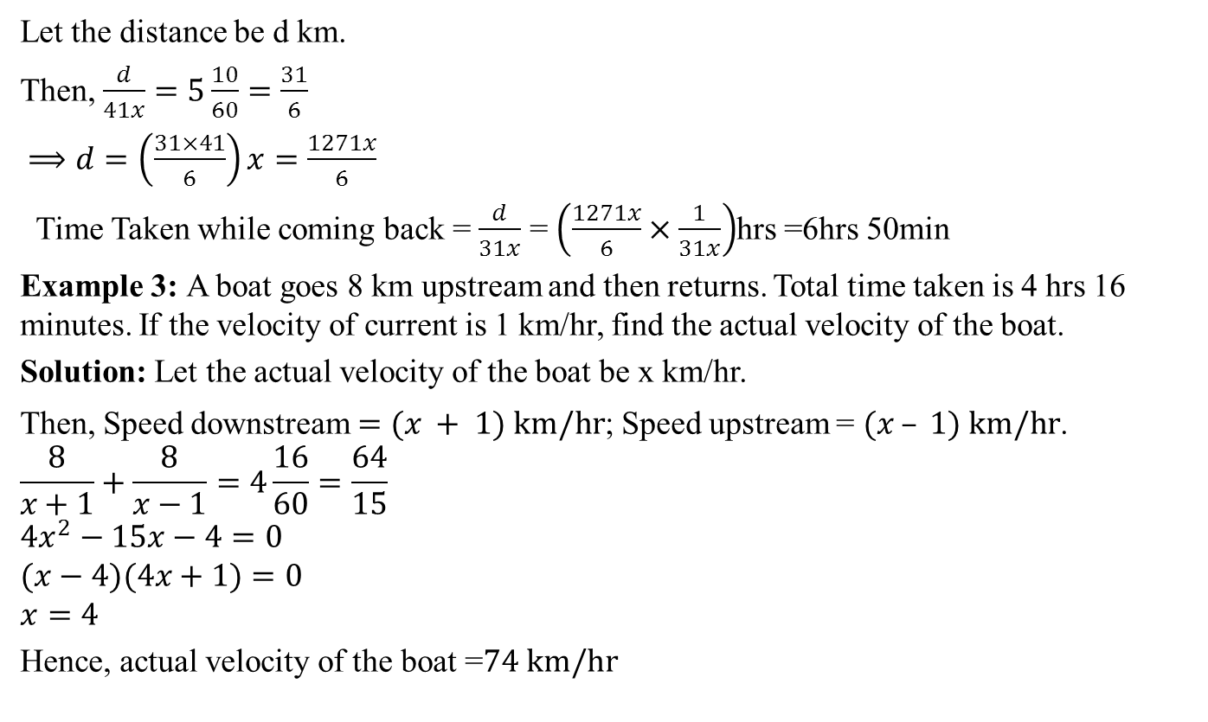
Boat and Stream (Contd.)
Let the distance be d km.
Then, $\frac{d}{41x}=5\frac{10}{60}=\frac{31}{6}$
$⟹d=\left(\frac{31×41}{6}\right)x=\frac{1271x}{6}$
Time Taken while coming back = $\frac{d}{31x}$ = $\left(\frac{1271x}{6}×\frac{1}{31x}\right)$hrs =6hrs 50min
Example 3: A boat goes 8 km upstream and then returns. Total time taken is 4 hrs 16 minutes. If the velocity of current is 1 km/hr, find the actual velocity of the boat.
Solution: Let the actual velocity of the boat be x km/hr.
Then, Speed downstream $=(x + 1) km/hr$; Speed upstream = $(x – 1) km/hr$.
$$\frac{8}{x+1}+\frac{8}{x−1}=4\frac{16}{60}=\frac{64}{15}$$
$$4x^{2}−15x−4=0$$
$$(x−4)(4x+1)=0$$
$$x=4$$
Hence, actual velocity of the boat =$74 km/hr$

Slide 55
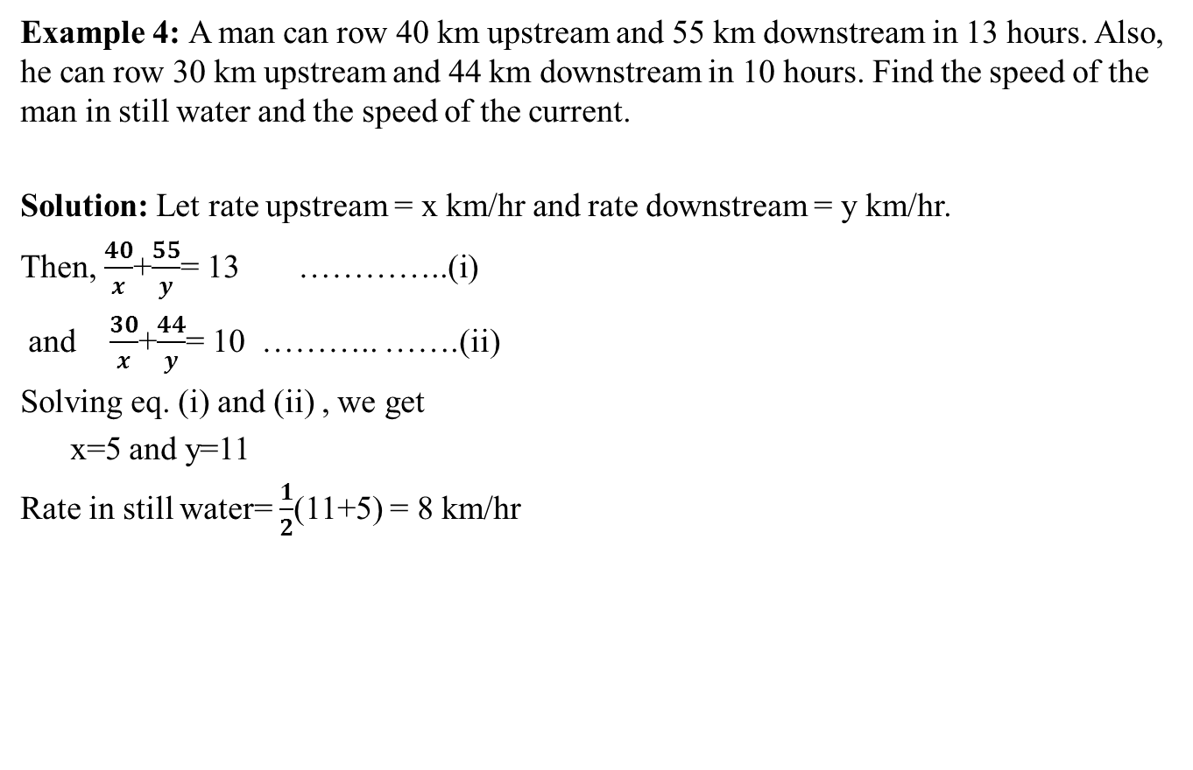
Multiple Choice Questions
Boat and Stream(Contd.)
^{n}
^{n}
Example 4: A man can row 40 km upstream and 55 km downstream in 13 hours. Also, he can row 30 km upstream and 44 km downstream in 10 hours. Find the speed of the man in still water and the speed of the current.
Solution: Let rate upstream = x km/hr and rate downstream = y km/hr.
Then, $\frac{40}{x}$+$\frac{55}{y}$= 13 …………..(i)
and $\frac{30}{x}$+$\frac{44}{y}$= 10 ……….. …….(ii)
Solving eq. (i) and (ii) , we get
x=5 and y=11
Rate in still water= $\frac{1}{2}$(11+5) = 8 km/hr

Slide 56
Multiple Choice Questions
Q.1: A boat goes 8 km in one hour along the stream and 2 km in one hour against the stream. The speed in km/hr of the stream is
(a) 2 (b) 3 (c) 4 (d) 5
Q.2: In one hour, a boat goes 11 km along the stream and 5 km against the stream. The speed of the boat in still water (in km/hr) is
(a) 3 (b) 5 (c) 8 (d) 9
Q.3: man rows downstream 32 km and 14 km upstream. If he takes 6 hours to cover each distance, then the velocity (in km/h) of the current is
(a)1/2 (b) 1 (c) 3/2 (d) 2
Q.4: A boatman rows 1 km in 5 minutes, along the stream and 6 km in 1 hour against the stream. The speed of the stream is
(a) 3 kmph (b) 6 kmph (c) 10 kmph (d) 12 kmph
Q.5: A boat takes half time in moving a certain distance downstream than upstream. What is the ratio between the rate in still water and the rate of current?
(a) 1 : 2 (b) 2 : 1 (c) 1 : 3 (d) 3 : 1

Slide 57
Multiple Choice Questions
Q.6: If a man goes 18 km downstream in 4 hours and returns against the stream in 12 hours, then the speed of the stream in km/hr is
(a) 1 (b) 1.5 (c) 1.75 (d) 3
Q.7: A boatman goes 2 km against the current of the stream in 1 hour and goes 1 km along the current in 10 minutes. How long will it take to go 5 km in stationary water?
(a) 40 minutes (b) 1 hour (c) 1 hr 15 min (d) 1 hr 30 min
Q.8: A boat, while going downstream in a river covered a distance of 50 miles at an average speed of 60 miles per hour. While returning, because of the water resistance, it took 1 hour 15 minutes to cover the same distance. What was the average speed during the whole journey?
(a) 40 mph (b) 48 mph (c) 50 mph (d) 55 mph
Q.9: If a boat goes 7 km upstream in 42 minutes and the speed of the stream is 3 kmph, then the speed of the boat in still water is
(a) 4.2 km/hr (b) 9 km/hr (c) 13 km/hr (d) 21 km/hr
Q.10: A man’s speed with the current is 15 km / hr and the speed of the current is 2.5 km / hr. The man’s speed against the current is
(a) 8.5 km/hr (b) 9 km/hr (c) 10 km/hr (d) 12.5 km/hr

Slide 58
Daily Quiz
There is a road beside a river. Two friends started from a place A, moved to a temple situated at another place B and then returned to A again. One of them moves on a cycle at a speed of 12 km / hr, while the other sails on a boat at a speed of 10 km / hr. If the river flows at the speed of 4 km / hr, which of the two friends will return to place A first?
The speed of the boat in still water is 5 times that of the current, it takes 1.1 hours to row to point B form point A downstream. The distance between point A and point B is 13.2km. How much distance (in km) will it cover in 312 minutes upstream?
A man takes 2.2 times as long to row a distance upstream as to row the same distance downstream. If he can row 55 km downstream in 2 hours 30 minutes, what is the speed of the boat in still water?

Slide 59
Assignment – 4
Q.1: A motor boat can travel at 10 km/hr in still water. It travelled 91 km downstream in a river a then returned taking altogether 20 hours. Find the rate of flow of the river.
(a) 3 km/hr (b) 5 km/hr (c) 6 km/hr (d) 8 km/hr
Q.2: The speed of a boat in still water is 10 km / hr. If it can travel 26 km downstream and 14 km upstream in the same time, the speed of the stream is
(a) 2 km/hr (b) 2.5 km/hr (c) 3 km/hr (d) 4 km/hr
Q.3: A boat takes 90 minutes less to travel 36 miles downstream than to travel the same distance upstream. If the speed of the boat in still water is 10 mph, the speed of the stream is
(a) 2 mph (b) 2.5 mph (c) 3 mph (d) 4 mph
Q.4: A boat goes 30 km upstream and 44 km downstream in 10 hours. In 13 hours, it can go 40 km upstream and 55 km downstream. The speed of the boat in still water is
(a) 3 km/hr (b) 4 km/hr (c) 8 km/hr (d) None of these

Slide 60
Assignment – 4(Contd.)
Q.5: A man wishes to cross a river perpendicularly. In still water he takes 4 minutes to cross the river, but in flowing river he takes 5 minutes. If the river is 100 metres wide, the velocity of the flowing water of the river is
(a) 10 m/min (b) 15 m/min (c) 20 m/min (d) 30 m/min
Q.6: A man takes 2.2 times as long to row a distance upstream as to row the same distance downstream. If he can row 55 km downstream in 2 hours 30 minutes, what is the speed of the boat in still water?
(a) 40 km/h (b) 8 km/h (c) 16 km/h (d) 24 km/h
Q.7: The speed of the boat in still water is 5 times that of the current, it takes 1.1 hours to row to point B form point A downstream. The distance between point A and point B is 13.2km. How much distance (in km) will it cover in 312 minutes upstream?
(a) 43.2 (b) 48 (c) 41.6 (d) 44.8

Slide 61
Assignment – 4(Contd.)
Q.8: P, Q and R are three towns on a river which flows uniformly. Q is equidistant from P and R. I row from P to Q and back in 10 hours and I can row from P to R in 4 hours. Compare the speed of my boat in still water with that of the river.
(a) 4 : 3 (b) 5 : 3 (c) 6 : 5 (d) 7 : 3
Q.9: A man can row upstream at 10 kmph and downstream at 18 kmph. Find the man’s rate in still water?
(a) 14 kmph (b) 4 kmph (c) 12 kmph (d) 10 kmph
Q.10: The speed of a boat in still water is 15 km / hr and the rate of current is 3 km / hr. The distance travelled downstream in 12 minutes is
(a) 1.2 km (b) 1.8 km (c) 2.4 km (d) 3.6 km

Slide 62
Sitting Arrangement
Key Concepts
Seating arrangement question usually involves an arrangement and you need to arrange the pattern in a way that it fulfills the conditions that the question demands. You are given 4 to 5 questions related to the arrangement. You are given both direct and indirect information which will help you in understanding how to go about the arrangement in an orderly manner.
These questions can be divided into different categories with the kind of seating arrangement that they provide you with. It can be divided into three categories or arrangements, these are:

Slide 63
Sitting Arrangement (Contd.)
Rectangular Arrangement: Here, you have to arrange people at a rectangular table. You need to keep in mind the directions so that you do not get confused.
Linear Arrangement: Here, you have to arrange people in a linear form, these type of questions are usually the simplest.
Circular Arrangement: This type of seating arrangement question is somewhat similar to a rectangular arrangement, except here, people need to arrange it in a circular form.
Double Row Arrangement: In these seating arrangement questions, people are to be arranged in two rows, usually facing each other.
Complex Row Arrangement: They are similar to linear arrangement questions in terms of arrangement and properties. Whereas linear arrangement has only one property – complex seating arrangement questions have multiple properties like positioning, objects etc.

Slide 64
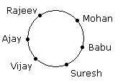
Sitting Arrangement (Contd.)
Example 1: 6 Boys are sitting in a circle and facing towards the Centre of the circle. Rajeev is sitting to the right of Mohan but he is not just at the left of Vijay. Suresh is between Babu and Vijay. Ajay is sitting to the left of Vijay. Who is sitting to the left of Mohan ?
Solution :
Hence, Babu is sitting to the left of Mohan.
Example 2: Eleven students A, B, C, D, E, F, G, H, I, J and K are sitting in first line facing to the teacher. D who is just to the left of F, is to the right of C at second place.
A is second to the right of E who is at one end. J is the nearest neighbour of A and B and is to the left of G at third place. H is next to D to the left and is at the third place to the right of I.

Slide 65
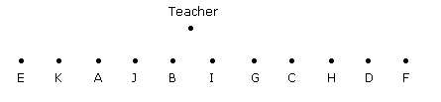
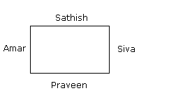
Sitting Arrangement (Contd.)
Solution: : : :
Hence, I is just in the middle.
Example 3: Siva, Sathish, Amar and Praveen are playing cards. Amar isto the right of Sathish, who is to the right of Siva. Who is to the right of Amar ?
Solution:
Hence Praveen is to the right of Amar.

Slide 66
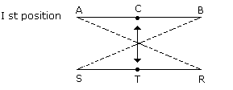
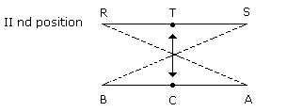
Sitting Arrangement (Contd.)
Example 4:A, B and C are three boys while R, S and T are three girls. They are sitting such that the boys are facing the girls. A and R are diagonally opposite to each other. C is not sitting at any of the ends. T is left to R but opposite to C.
(A) Who is sitting opposite to B ? (B) Who is sitting diagonally opposite to B ?
Solution:
(A)Hence, R is sitting opposite to B.
(B) Hence, S is sitting diagonally opposite to B.

Slide 67
Multiple Choice Questions
Q. 1: A, P, R, X, S and Z are sitting in a row. S and Z are in the Centre. A and P are at the ends. R is sitting to the left of A. Who is to the right of P ?
A (b) X ( c) S (d) Z
Q.2:There are 8 houses in a line and in each house only one boy lives with the conditions as given below:
Jack is not the neighbor Simon .Harry is just next to the left of Larry. There is at least one to the left of Larry. Paul lives in one of the two houses in the middle. Mike lives in between Paul and Larry. If at least one lives to the right of Robert and Harry is not between Taud and Larry, then which one of the following statement is not correct ?
If at least one lives to the right of Robert and Harry is not between Taud and Larry, then which one of the following statement is not correct ?
(a) Robert is not at the left end (b) Robert is in between Simon and Taud
(c) Taud is in between Paul and Jack. (d) There are three persons to the right of Paul.

Slide 68
Multiple Choice Questions
Q. 3:A, B, C, D and E are sitting on a bench. A is sitting next to B, C is sitting next to D, D is not sitting with E who is on the left end of the bench. C is on the second position from the right. A is to the right of B and E. A and C are sitting together. In which position A is sitting ?
(a) Between B and D (b) Between B and C
(c) Between E and D (d) Between C and E
Q.4: P, Q, R, S, T, U, V and W are sitting round the circle and are facing the Centre:
P is second to the right of T who is the neighbour of R and V. S is not the neighbour of P.V is the neighbour of U. Q is not between S and W. W is not between U and S.
(i) Which two of the following are not neighbours ?
RV (b) UV (c) RP (d) QW
(ii) Which one is immediate right to the V ?
(a) P (b) U (c) R (d) T

Slide 69
Multiple Choice Questions
(iii) Which of the following is correct ?
P is to the immediate right of Q (b) R is between U and V
(c) Q is to the immediate left of W (d) U is between W and S
(iv) What is the position of S ?
(a) Between U and V (b)Second to the right of P
(c) To the immediate right of W (d) Data inadequate.

Slide 70
Daily Quiz
Five girls are sitting on a bench to be photographed. Seema is to the left of Rani and to the right of Bindu. Mary is to the right of Rani. Reeta is between Rani and Mary.
(i) Who is sitting immediate right to Reeta ?
(ii) Who is in the middle of the photograph ?
(iii) Who is second from the right ?
(iv) Who is second from the left in photograph ?

Slide 71
Assingment-5
Q.1: Six friends are sitting in a circle and are facing the centre of the circle. Deepa is between Prakash and Pankaj. Priti is between Mukesh and Lalit. Prakash and Mukesh are opposite to each other.
(i) Who is sitting right to Prakash ?
Mukesh (b) Deepa (c) Pankaj ( d) Lalit
(ii) Who is just right to Pankaj ?
Deepa (b)Lalit (c ) Prakash (d)Priti
(iii) Who are the neighbours of Mukesh ?
Prakash and Deepa (b) Deepa and Priti (c ) Priti and Pankaj (d) Lalit and Priti
(iv) Who is sitting opposite to Priti ?
(a) Prakash (b) Deepa (c) Pankaj (d )Lalit

Slide 72
Assinment-5(Contd.)
Q.2: Six girls are sitting in a circle facing to the centre of the circle. They are P, Q, R, S, T and V. T is not between Q and S but some other one. P is next to the left of V. R is 4th to the right of P.
(i) Which of the following statement is not true ?
(a) S is just next to the right to R (b) T is just next to the right of V
(c) R is second to the left of T (d) P is second to the right of R
(ii) If P and R interchange their positions then which of the following pair will sit together ?
RT (b) PV (c) VT (d) QV
(iii) What is the position of T ?
Just next to the right of Q (b) Second to the left of P
(c ) Between Q and R (d)To the immediate right of V
(iv)Which one is sitting just right to the V?
(a) P (b) T (c) R (d) S/Q

Slide 73
Clocks & Calendar
IMPORTANT FACTS
The face or dial of a watch is a circle whose circumference is divided into 60 equal parts, called minute spaces.
A clock has two hands, the smaller one is called the hour hand or short hand while the larger one is called the minute hand or long hand.
(i) In 60 minutes, the minute hand gains 55 minutes on the hour hand.
(ii) In every hour, both the hands coincide once.
(iii) The hands are in the same straight line when they are coincident or opposite to each other.
(iv) When the two hands are at right angles, they are 15 minute spaces apart.
(v) When the hands are in opposite directions, they are 30 minute spaces apart.
(vi) Angle traced by hour hand in 12 hrs = 360°.
(vii) Angle traced by minute hand in 60 min. = 360°.

Slide 74
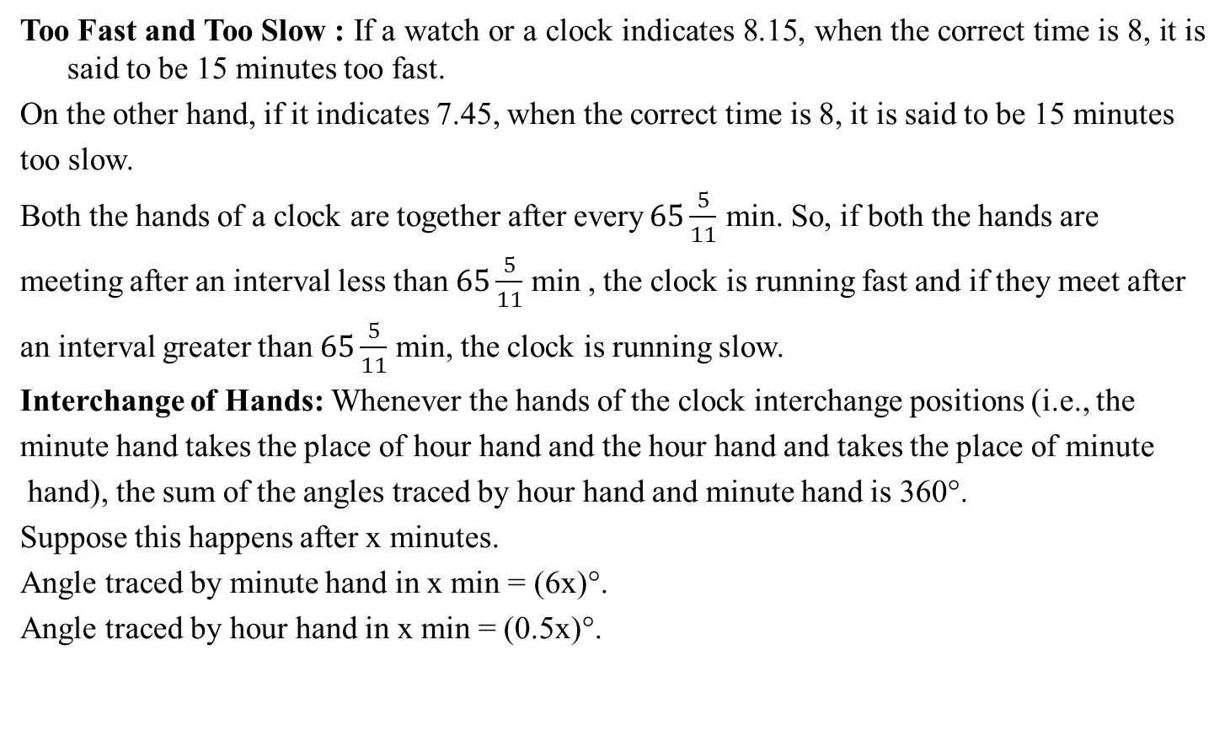
Clocks & Calendar(Contd.)
Too Fast and Too Slow : If a watch or a clock indicates 8.15, when the correct time is 8, it is said to be 15 minutes too fast.
On the other hand, if it indicates 7.45, when the correct time is 8, it is said to be 15 minutes
too slow.
Both the hands of a clock are together after every$65\frac{5}{11}$ min. So, if both the hands are
meeting after an interval less than $65\frac{5}{11}$ min , the clock is running fast and if they meet after
an interval greater than $65\frac{5}{11}$ min, the clock is running slow.
Interchange of Hands: Whenever the hands of the clock interchange positions (i.e., the
minute hand takes the place of hour hand and the hour hand and takes the place of minute
hand), the sum of the angles traced by hour hand and minute hand is 360°.
Suppose this happens after x minutes.
Angle traced by minute hand in x min = (6x)°.
Angle traced by hour hand in x min = (0.5x)°.

Slide 75
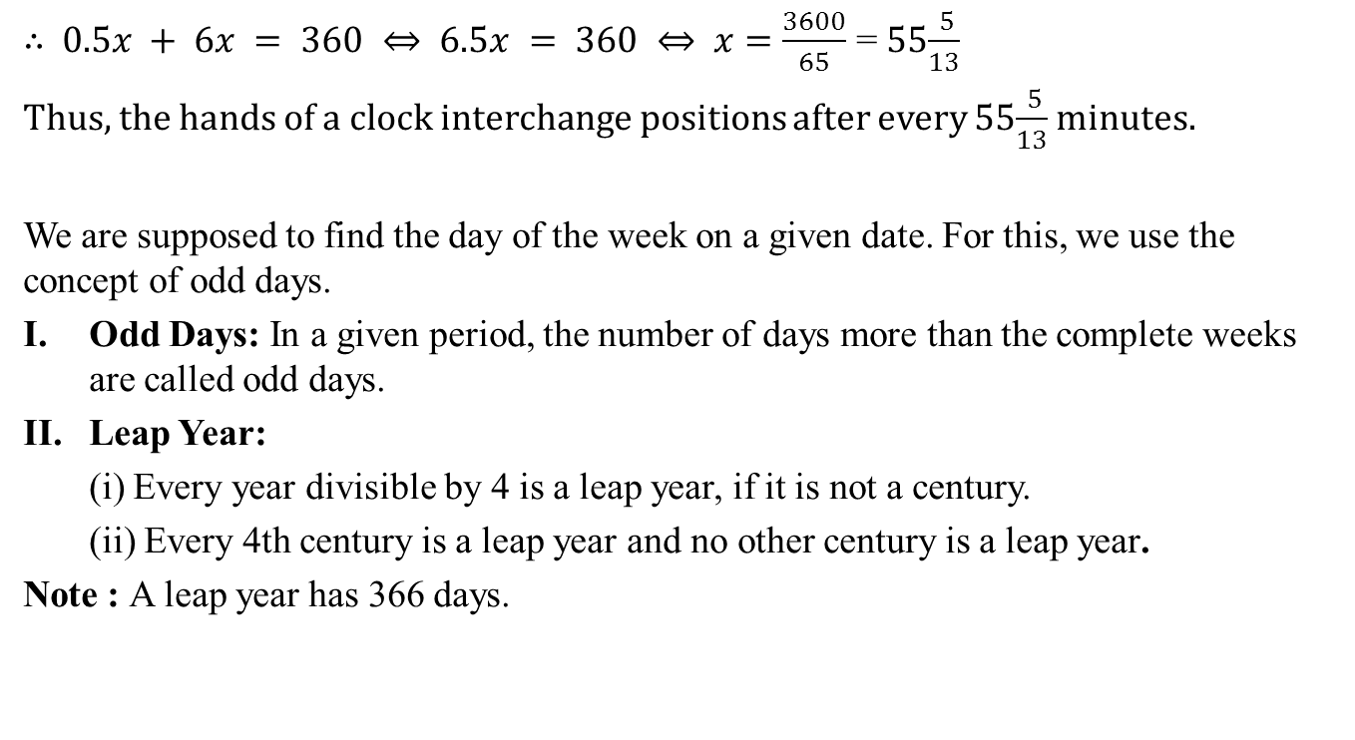
Clocks & Calendar(Contd.)
$∴$ $0.5x + 6x = 360 ⇔ 6.5x = 360 ⇔ x$ $=\frac{3600}{65}$ = 55$\frac{ 5}{13}$
Thus, the hands of a clock interchange positions after every 55$\frac{ 5}{13}$ minutes.
We are supposed to find the day of the week on a given date. For this, we use the concept of odd days.
Odd Days: In a given period, the number of days more than the complete weeks are called odd days.
Leap Year:
(i) Every year divisible by 4 is a leap year, if it is not a century.
(ii) Every 4th century is a leap year and no other century is a leap year.
Note : A leap year has 366 days.

Slide 76
Clocks & Calendar(Contd.)
III. Ordinary Year: The year which is not a leap year is called an ordinary year. An
ordinary year has 365 days.
IV. Counting of Odd Days:
(i) 1 ordinary year = 365 days = (52 weeks + 1day).
∴ 1 ordinary year has 1 odd day.
(ii) 1 leap year = 366 days = (52 weeks + 2 days).
∴ 1 leap year has 2 odd days.
(iii) 100 years = 76 ordinary years + 24 leap years
= (76 × 1 + 24 × 2) odd days = 124 odd days
= (17 weeks + 5 days) ≡ 5 odd days.

Slide 77
Clocks & Calendar(Contd.)
∴ Number of odd days in 100 years = 5
Number of odd days in 200 years = (5 × 2) ≡ 3 odd days
Number of odd days in 300 years = (5 × 3) ≡ 1 odd day.
Number of odd days in 400 years = (5 × 4 + 1) ≡ 0 odd day.
Similarly, each one of 800 years, 1200 years, 1600 years, 2000 years, etc. has 0 odd days.
V. Day of the Week Related to Odd Days:
No. of days | 0 | 1 | 2 | 3 | 4 | 5 | 6
Day | Sun. | Mon. | Tues. | Wed. | Thurs. | Fri. | Sat.

Slide 78
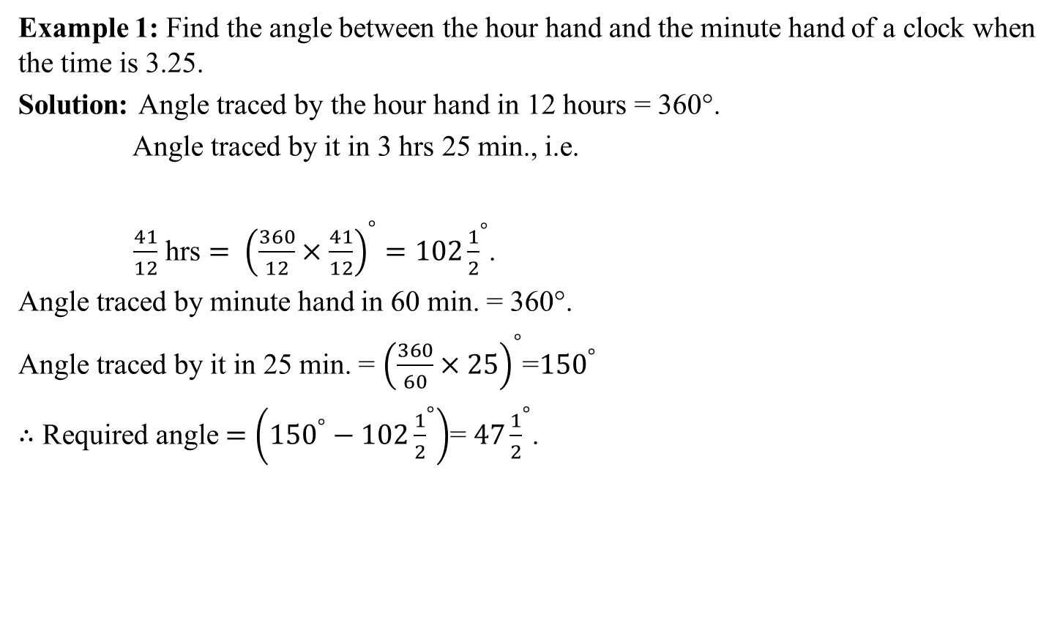
Clocks & Calendar(Contd.)
Example 1: Find the angle between the hour hand and the minute hand of a clock when the time is 3.25.
Solution: Angle traced by the hour hand in 12 hours = 360°.
Angle traced by it in 3 hrs 25 min., i.e.
$\frac{41}{12}$ hrs $= {\left(\frac{360}{12}×\frac{41}{12}\right)}^{°}=102{\frac{1}{2}}^{°}$.
Angle traced by minute hand in 60 min. = 360°.
Angle traced by it in 25 min. = ${\left(\frac{360}{60}×25\right)}^{°}$=${150}^{°}$
$∴$ Required angle $=\left({150}^{°}−102{\frac{1}{2}}^{°}\right)$= $47{\frac{1}{2}}^{°}$.

Slide 79
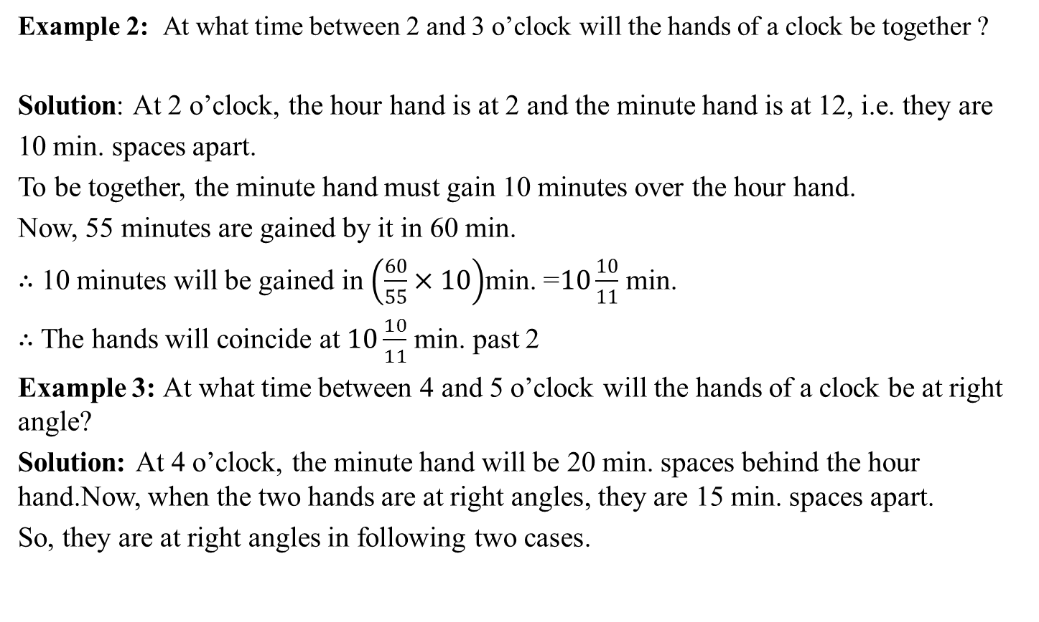
Clocks & Calendar(Contd.)
Example 2: At what time between 2 and 3 o’clock will the hands of a clock be together ?
Solution: At 2 o’clock, the hour hand is at 2 and the minute hand is at 12, i.e. they are
10 min. spaces apart.
To be together, the minute hand must gain 10 minutes over the hour hand.
Now, 55 minutes are gained by it in 60 min.
∴ 10 minutes will be gained in $\left(\frac{60}{55}×10\right)$min. =$10\frac{10}{11}$ min.
∴ The hands will coincide at $10\frac{10}{11}$ min. past 2
Example 3: At what time between 4 and 5 o’clock will the hands of a clock be at right angle?
Solution: At 4 o’clock, the minute hand will be 20 min. spaces behind the hour hand.Now, when the two hands are at right angles, they are 15 min. spaces apart.
So, they are at right angles in following two cases.

Slide 80
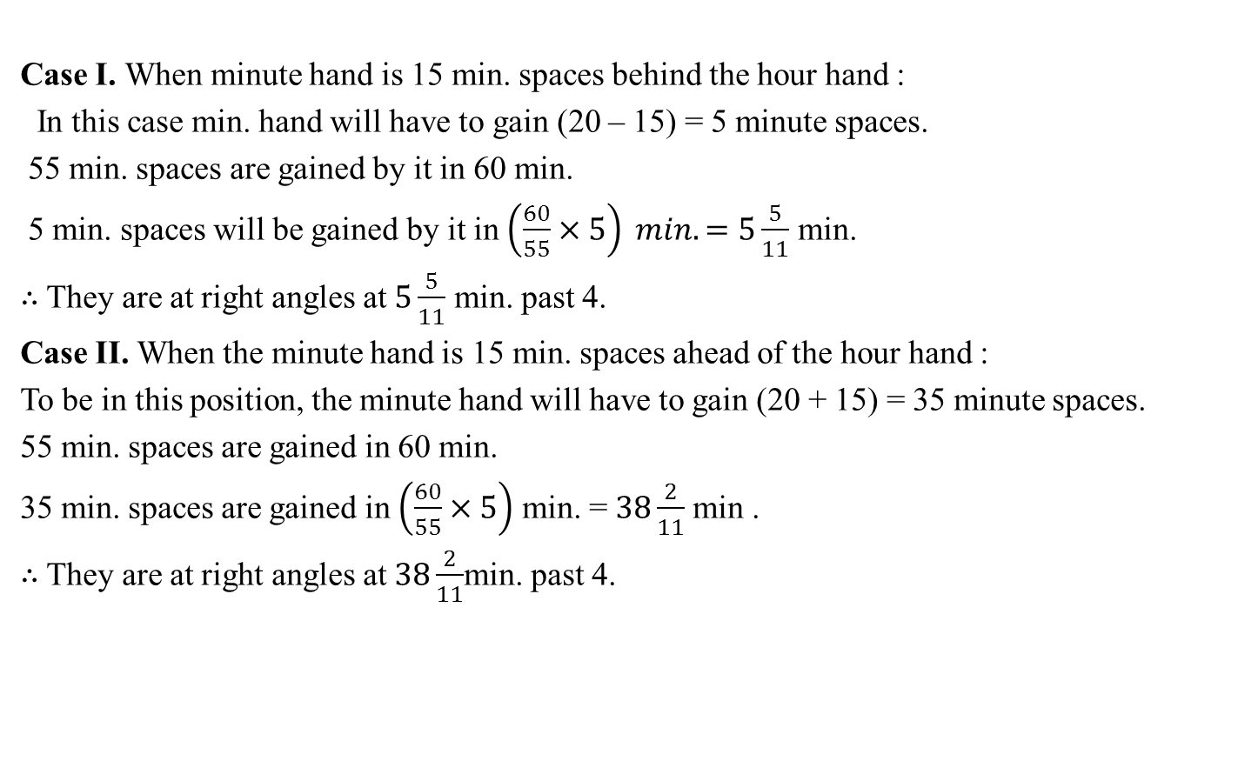
Clocks & Calendar(Contd.)
Case I. When minute hand is 15 min. spaces behind the hour hand :
In this case min. hand will have to gain (20 – 15) = 5 minute spaces.
55 min. spaces are gained by it in 60 min.
5 min. spaces will be gained by it in $\left(\frac{60}{55}×5\right) min.=5\frac{5}{11}$ min.
∴ They are at right angles at $5\frac{5}{11}$ min. past 4.
Case II. When the minute hand is 15 min. spaces ahead of the hour hand :
To be in this position, the minute hand will have to gain (20 + 15) = 35 minute spaces.
55 min. spaces are gained in 60 min.
35 min. spaces are gained in $\left(\frac{60}{55}×5\right)$ min. = $38\frac{2}{11}$ min .
∴ They are at right angles at $38\frac{2}{11}$min. past 4.

Slide 81
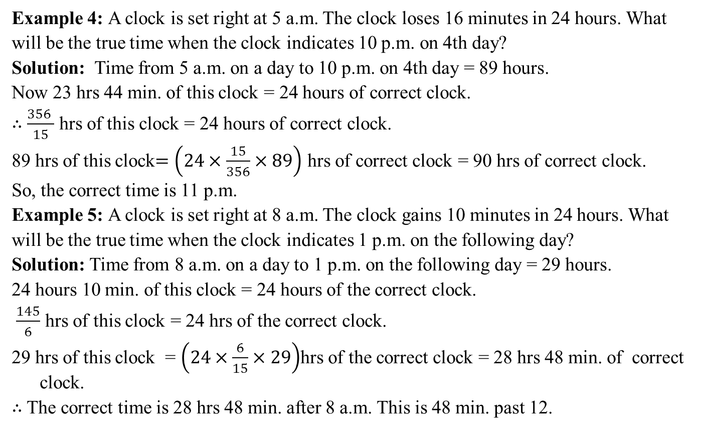
Clocks & Calendar(Contd.)
Example 4: A clock is set right at 5 a.m. The clock loses 16 minutes in 24 hours. What
will be the true time when the clock indicates 10 p.m. on 4th day?
Solution: Time from 5 a.m. on a day to 10 p.m. on 4th day = 89 hours.
Now 23 hrs 44 min. of this clock = 24 hours of correct clock.
∴ $\frac{356 }{15}$ hrs of this clock = 24 hours of correct clock.
89 hrs of this clock$=\left(24×\frac{15}{356}×89\right)$ hrs of correct clock = 90 hrs of correct clock.
So, the correct time is 11 p.m.
Example 5: A clock is set right at 8 a.m. The clock gains 10 minutes in 24 hours. What
will be the true time when the clock indicates 1 p.m. on the following day?
Solution: Time from 8 a.m. on a day to 1 p.m. on the following day = 29 hours.
24 hours 10 min. of this clock = 24 hours of the correct clock.
$\frac{145}{6}$ hrs of this clock = 24 hrs of the correct clock.
29 hrs of this clock = $\left(24×\frac{6}{15}×29\right)$hrs of the correct clock = 28 hrs 48 min. of correct clock.
∴ The correct time is 28 hrs 48 min. after 8 a.m. This is 48 min. past 12.

Slide 82
Clocks & Calendar(Contd.)
Example 6 : What was the day of the week on 16th July, 1776?
Solution: 16th July, 1776 = (1775 years + Period from 1.1.1776 to 16.7.1776)
Counting of odd days:
Number of odd days in 1600 years = 0
Number of odd days in 100 years = 5
75 years = 18 leap years + 57 ordinary years
= (18 × 2 + 57 × 1) odd days = 93 odd days
= (13 weeks + 2 days) ≡ 2 odd days
∴ 1775 years have
= (0 + 5 + 2) odd days = 7 odd days ≡ 0 odd day.
Jan. Feb. March April May June July (31 + 29 + 31 + 30 + 31 + 30 + 16) = 198 days
198 days = (28 weeks + 2 days) ≡ 2 odd days.
∴ Total number of odd days = (0 + 2) = 2.
Hence, the required day is Tuesday.

Slide 83
Clocks & Calendar(Contd.)
Example 7:On what dates of March 2005 did Friday fall?
Sulution: First we find the day on 1.3.2005
1.3.2005 = (2004 years + Period from 1.1.2005 to 1.3.2005)
Odd days in 1600 years = 0 Odd days in 400 years = 0
4 years = (1 leap year + 3 ordinary years)
= (1 × 2 + 3 × 1) odd days = 5 odd days
Jan. Feb. March
(31 + 28 + 11)
= 60 days = (8 weeks + 4 days) ≡ 4 odd days.
Total number of odd days = (0 + 0 + 5 + 4) = 9 ≡ 2 odd days
∴ 1.3.2005 was Tuesday. So, Friday lies on 4.3.2005
Hence, Friday lies on 4th, 11th, 18th and 25th of March, 2005.

Slide 84
Clocks & Calendar(Contd.)
Example 8: Prove that the calendar for the year 2003 will serve for the year 2014.
Solution: We must have same day on 1.1.2003 and 1.1.2014.
So, number of odd days between 31.12.2002 and 31.12.2013 must be 0.
This period has 3 leap years and 8 ordinary years.
Number of odd days = (3 × 2 + 8 × 1) = 14 ≡ 0 odd day
∴ Calendar for the year 2003 will serve for the year 2014.

Slide 85
Multiple Choice questions
Q. 1: January 1, 2007 was Monday. What day of the week lies on Jan. 1, 2008?
(a) Monday (b) Tuesday (c) Wednesday (d) Sunday
Q. 2: The calendar for the year 2007 will be the same for the year:
(a) 2014 (b) 2016 (c) 2017 (d) 2018
Q.3: On what dates of April, 2001 did Wednesday fall?
(a) 1st, 8th, 15th, 22nd, 29th (b) 2nd, 9th, 16th, 23rd, 30th
(c) 3rd, 10th, 17th, 24th (d) 4th, 11th, 18th, 25th
Q. 4: What was the day of the week on 17th June, 1998?
Monday (b) Tuesday (c) Wednesday (d) Thursday
Q.5: What was the day of the week on 28th May, 2006?
(a) Thursday (b) Friday (c) Saturday (d) Sunday

Slide 86
Multiple Choice questions
Q.6: London time is five and a half hours behind Delhi time. What time is it in London if it is 0.2.35 in Delhi?
(a) 07.05 (b) 08.05 (c) 21.05 (d) 21.35
Q.7: How many rotations will the hour hand of a clock complete in 72 hours?
(a)3 (b) 6 (c) 9 (d) 12
Q.8: Through what angle does the minute hand of a clock turn in 5 minutes?
(a) 30° (b) 32° (c) 35° (d) 36°
Q. 9: The angle between the minute hand and the hour hand of a clock when the time is 8.30, is
(a) 80° (b) 75° (c) 60° (d) 105°
Q.10: An accurate clock shows the time as 3.00. After the hour hand has moved 135°, the time would be
(a) 6.30 (b) 7.30 (c) 8.00 (d) 9.30

Slide 87
Daily Quiz
At which time number of minutes elapsed since midnight is nine times the number of minutes before noon?
How many times do the hands of a clock coincide in a day?
What will be the day of the week on 15th August, 2010?
How many days are there in x weeks x days?

Slide 88
Assignment-6
Q.1: It was Sunday on Jan 1, 2006. What was the day of the week on Jan 1, 2010?
(a) Sunday (b) Saturday (c) Friday (d) Wednesday
Q.2: On 8th Feb, 2005 it was Tuesday. What was the day of the week on 8th Feb, 2004?
(a) Tuesday (b) Monday (c) Sunday (d) Wednesday
Q.3: For a certain month, the dates of three of the Sundays are even numbers. Then, the 15th of the that month falls on a
(a) Thursday (b) Friday (c) Saturday (d) Sunday
Q.4: What was the day of the week on 15 August, 1947?
(a) Saturday (b) Friday (c) Thursday (d) Wednesday
Q.5:The calendar for the year 2009 will be the same as that of the year
(a) 2013 (b) 2012 (c) 2015 (d) 2014

Slide 89
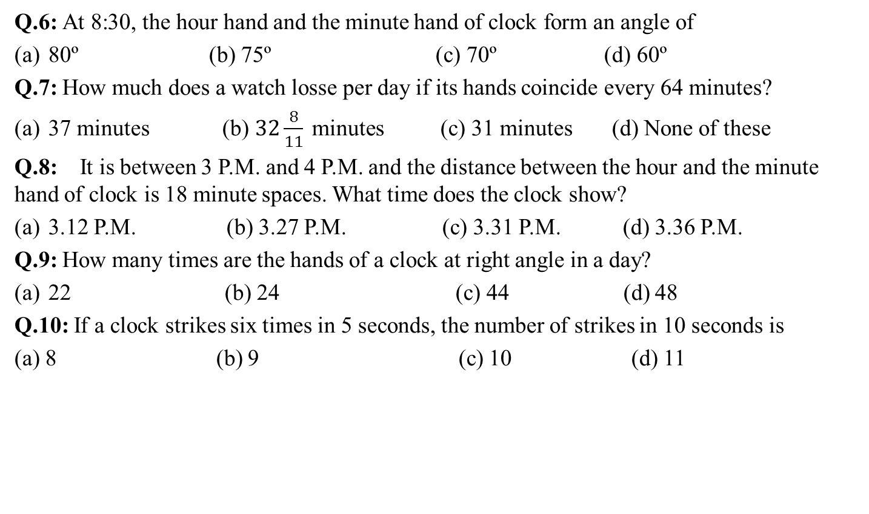
Assignment-6 (Contd.)
Q.6: At 8:30, the hour hand and the minute hand of clock form an angle of
80º (b) 75º (c) 70º (d) 60º
Q.7: How much does a watch losse per day if its hands coincide every 64 minutes?
37 minutes (b) $32\frac{8}{11} \text{minutes}$ (c) 31 minutes (d) None of these
Q.8: It is between 3 P.M. and 4 P.M. and the distance between the hour and the minute hand of clock is 18 minute spaces. What time does the clock show?
3.12 P.M. (b) 3.27 P.M. (c) 3.31 P.M. (d) 3.36 P.M.
Q.9: How many times are the hands of a clock at right angle in a day?
22 (b) 24 (c) 44 (d) 48
Q.10: If a clock strikes six times in 5 seconds, the number of strikes in 10 seconds is
(a) 8 (b) 9 (c) 10 (d) 11

Slide 90
Summary
Course Objective
COs and POs of subject
Mapping of COs and Pos
Prerequisite and Recap
Time & Work
Pipe & Cistern
Time, Speed & Distance
Boat & Stream
Sitting Arrangement
Clocks & Calendar

Slide 91
Faculty Video Links, Youtube Links and Online Courses Details
Suggested Links:
Time & Work
https://youtu.be/KE7tQf9spPg
Pipe & Cistern
https://youtu.be/mBtBD1N7ywQ
Time, Speed & Distance
https://youtu.be/jzNxXm5twx4
Boat & Stream
https://youtu.be/-EdJ4kAW-j4
Sitting Arrangement
https://youtu.be/mwY4yXB9Ymg
Clocks & Calendar
https://youtu.be/edEvlh0tqzk

Slide 92
Reference
Website - https://www.GovernmentAdda.com
Books references – R.S. Agrawal
Thank You

